Slide 1
How collaboration between private sector and governments can enhance sustainable commodity production
VALUE BEYOND VALUE CHAINS
© UNDP Paraguay

Slide 2
Index
Introduction
Executive summary
Why do we need transformation in commodities production?
Why should companies and financial institutions engage beyond their value chains?
What value does engaging beyond value chains create?
What does engaging beyond value chains mean in practice?
How can businesses and financial institutions engage with different levels of government?
What kinds of support can businesses and financial institutions provide outside their value chains?
What does engaging beyond value chains mean for different parts of the value chain?
What does engaging beyond value chains mean for different parts of an organisation?
How does this all come together, and where can you go next?

Slide 3
Index
Case studies: how businesses and financial institutions can collaborate
I. Examples of multi-stakeholder collaboration at different government levels
NATIONAL: Indonesia Sustainable Palm Oil Platform (National Implementation Team)
PROVINCIAL: North Sumatra Platform (Provincial Implementation Team)
DISTRICT: Siak Pelalawan Landscape Programme
LANDSCAPE & MULTI-SCALE (Provincial & District): Coalition for Sustainable Livelihoods (CSL)
II. Examples of business engagement collaborating for impact beyond their value chains
Cocoa & Forests Initiative
The Soft Commodities Forum
The Cerrado Working Group/Grupo de Trabalho do Cerrado (GTC)
Consumer Goods Forum (CGF) Forest Positive Coalition
III. Examples of actions taken by companies and financial institutions in different parts of the value chain
PRODUCERS: Wilmar International
TRADERS: Olam Food Ingredients
MANUFACTURES: Unilever
RETAILERS: Walmart
FINANCE: Rabobank
FINANCE: &Green

Slide 4
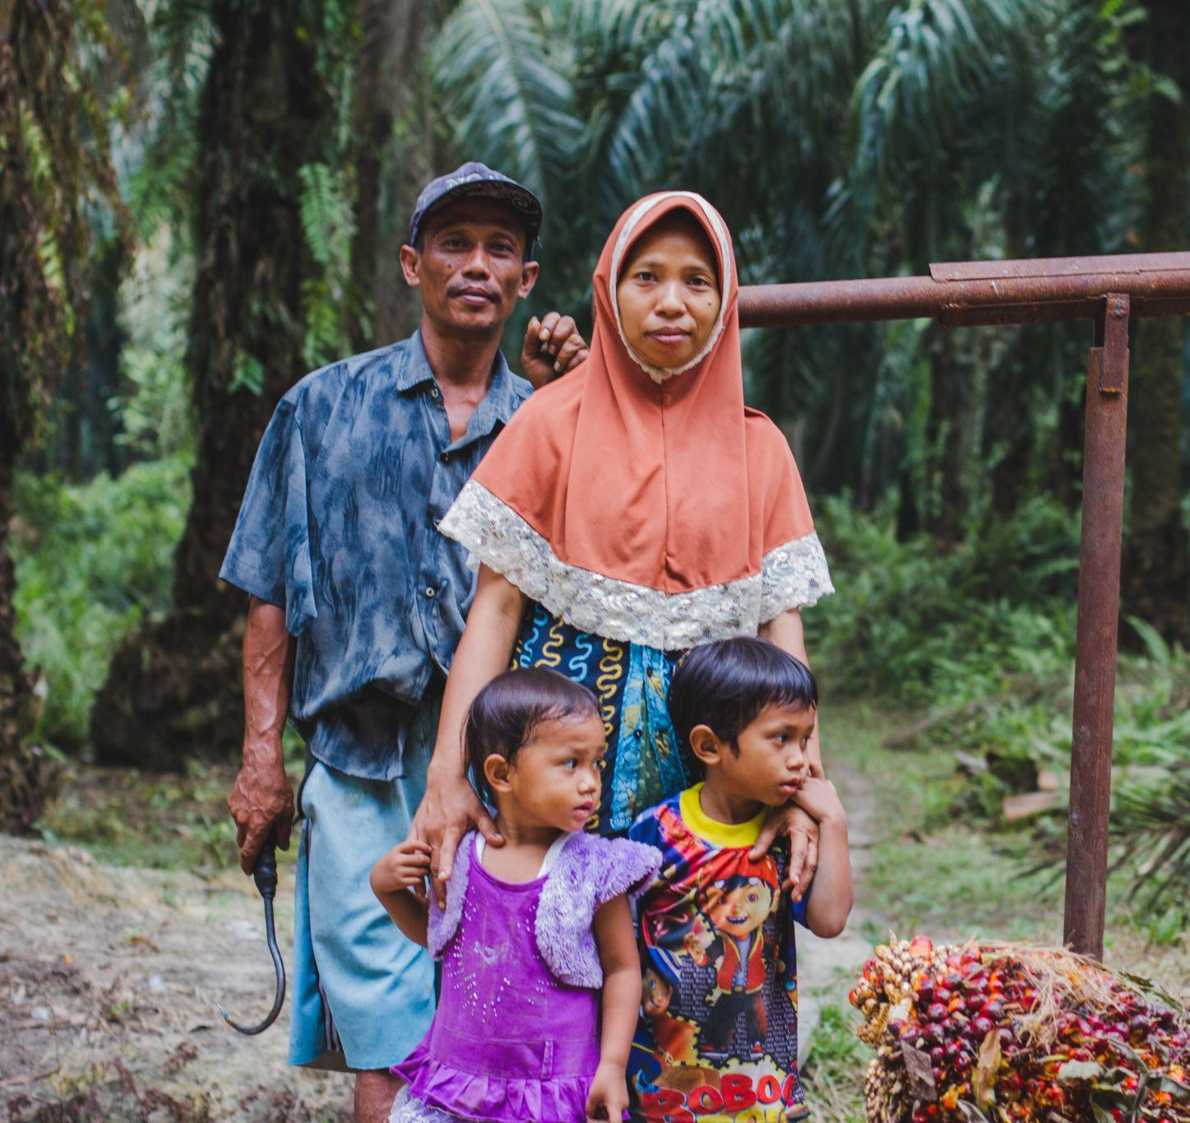
Introduction
© UNDP Indonesia/Agusriady Saputra

Slide 5
What is the purpose of this document?
Building on the work of the Value Beyond Value Chains (VBV) initiative, led by UNDP and supported by the Good Growth Partnership, and the insights of other leading institutions, this presentation highlights why cross-sectoral collaboration is essential to drive improved commodity sustainability and reduce tropical deforestation, and introduces how private sector companies and financial institutions can begin engaging with sustainability efforts beyond their value chains at different levels of government – to generate both business benefits and positive systemic impact. This document is supplemented by the Value Beyond Value Chains Case Studies Collection.

Slide 6
Who is this document for?
The presentation aims to equip senior decision makers in companies in commodity supply chains, or financial institutions who invest in them, with key information on how to address critical production and supply chain risks by engaging with multi-stakeholder processes (i.e., beyond their value chains).
Good Growth Partnership members and collaborators are welcome to use this deck (or any combination of slides from it) to interact directly with business leaders who are interested to learn more. This deck, including customised versions of it, can also be prepared and shared with business for their own use and engagement with internal stakeholders.

Slide 7
What does this document cover?
This deck contains a series of small “chapters” that can be sequenced according to need. They cover:
The systemic challenges and opportunities associated with agricultural commodities.
Why collaborative action beyond value chains is essential to mitigate risks and drive sustainable development for the long term.
How engaging with different levels of government (national, landscape, provincial, district) can contribute to both business benefits and industry transformation.
How companies in different parts of the value chain, and different business functions, can begin to take collaborative action for impact beyond their value chains.
Case studies and key resources to refer to next for more detailed advice on how to implement.

Slide 8
How do I use this document?
This document is intended as a modular deck that can be tailored according to needs.
The full version of the deck (88 slides) is readily useable and can be read and circulated to key internal decision-makers or partners as a guidance note in pdf format. Depending on the maturity of your audience or the specific objectives of an engagement you are undertaking, you can also choose to select specific slides or sections to remove or focus on. You could also, for example, insert certain case studies provided at the end of the document into a part of the presentation you want to focus on.
To customise the deck, simply save a local version for your use and begin editing. You can share it as a pdf or share directly as a presentation.

Slide 9
Executive summary
©️ Government of Mato Grosso

Slide 10
Why do we need transformation in commodities production?
EXECUTIVE SUMMARY
Unsustainable commodity production is creating major risks.
Environmental and social challenges threaten food production globally, especially in tropical commodity producing landscapes and supply chains.
But overcoming these systemic challenges offers huge reward.
Transforming tropical commodity production in landscapes and supply chains will ensure future productivity and security, improve livelihoods and protect crucial ecosystems and natural resources.
©️ Benjamin Drummond

Slide 11
Why should companies and financial institutions engage beyond their value chains?
EXECUTIVE SUMMARY
For companies, inaction carries both short-term and longer-term risks.
Rapid action to address unsustainable production can protect revenue and reputation, while ensuring a stable operating environment. Reversing damage in future will be much more difficult and costly.
The drivers of unsustainable production are challenging to overcome.
Global supply chain systems are complex, with underlying drivers related to policy, financing, and market demand, posing major challenges for companies and financial institutions seeking to improve.
To drive transformation, companies must act beyond their value chains.
Most existing action for sustainable commodities is focused on company operations and supply chains, leaving the enabling environment for sustainability unchanged.
©️ UNDP Paraguay

Slide 12
What value does engaging beyond value chains create?
EXECUTIVE SUMMARY
Addressing the enabling environment raises standards across the board.
By working with governments to strengthen policy, enforcement and standards the enabling environment can turn good practice into standard practice and share the cost of sustainability between companies.
Collaborating to “lift the floor” supports long- and short-term priorities.
As well as reducing the operational and systemic risks that companies face, engaging beyond value chains can increase access to finance, reduce costs & improve reputation.
©️ UNDP Liberia

Slide 13
What does engaging beyond value chains mean in practice?
EXECUTIVE SUMMARY
Companies can “engage beyond value chains” in several ways.
Typically, engaging beyond value chains means working with other stakeholders, including governments, to define shared goals and develop action plans.
How to engage beyond value chains depends on where you are now.
To understand your company’s ability to participate in multi-stakeholder processes at different levels and get started, you should begin by asking:
How big is your company
What part of the value chain do you operate in
Which sourcing regions are strategically important
What local presence and capacity do you have
How mature is your sustainability strategy.
Companies can choose their level of engagement whilst giving support.
Decision-makers can prioritise which initiatives are most important to engage with – and can also choose their level of engagement according to their strategic priorities.
©️ Shutterstock

Slide 14
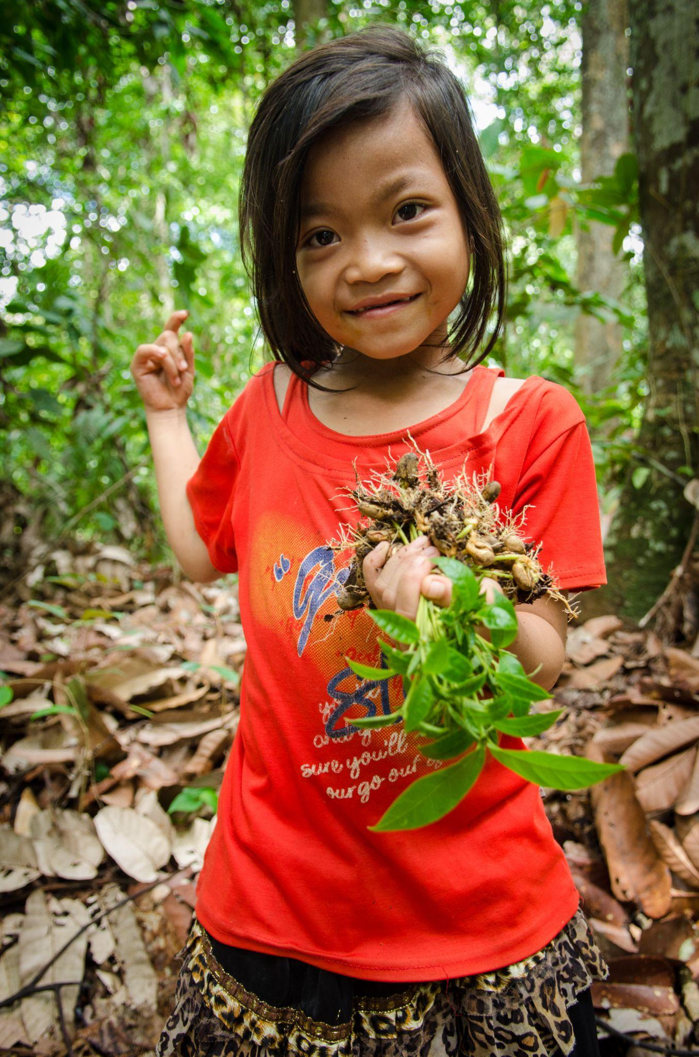
How can businesses engage with different levels of government?
EXECUTIVE SUMMARY
Companies should work with different levels of government…
Engagement at national level is a crucial aspect of engaging beyond value chains; national governments are responsible for critical aspects of the enabling environment and for setting the level of ambition in their countries.
… and identify the right scale to work with according to needs.
Sub-national landscape and jurisdictional initiatives are a central way through which companies can accelerate commodity transformation in key regions and sectors.
©️ UNDP Indonesia

Slide 15
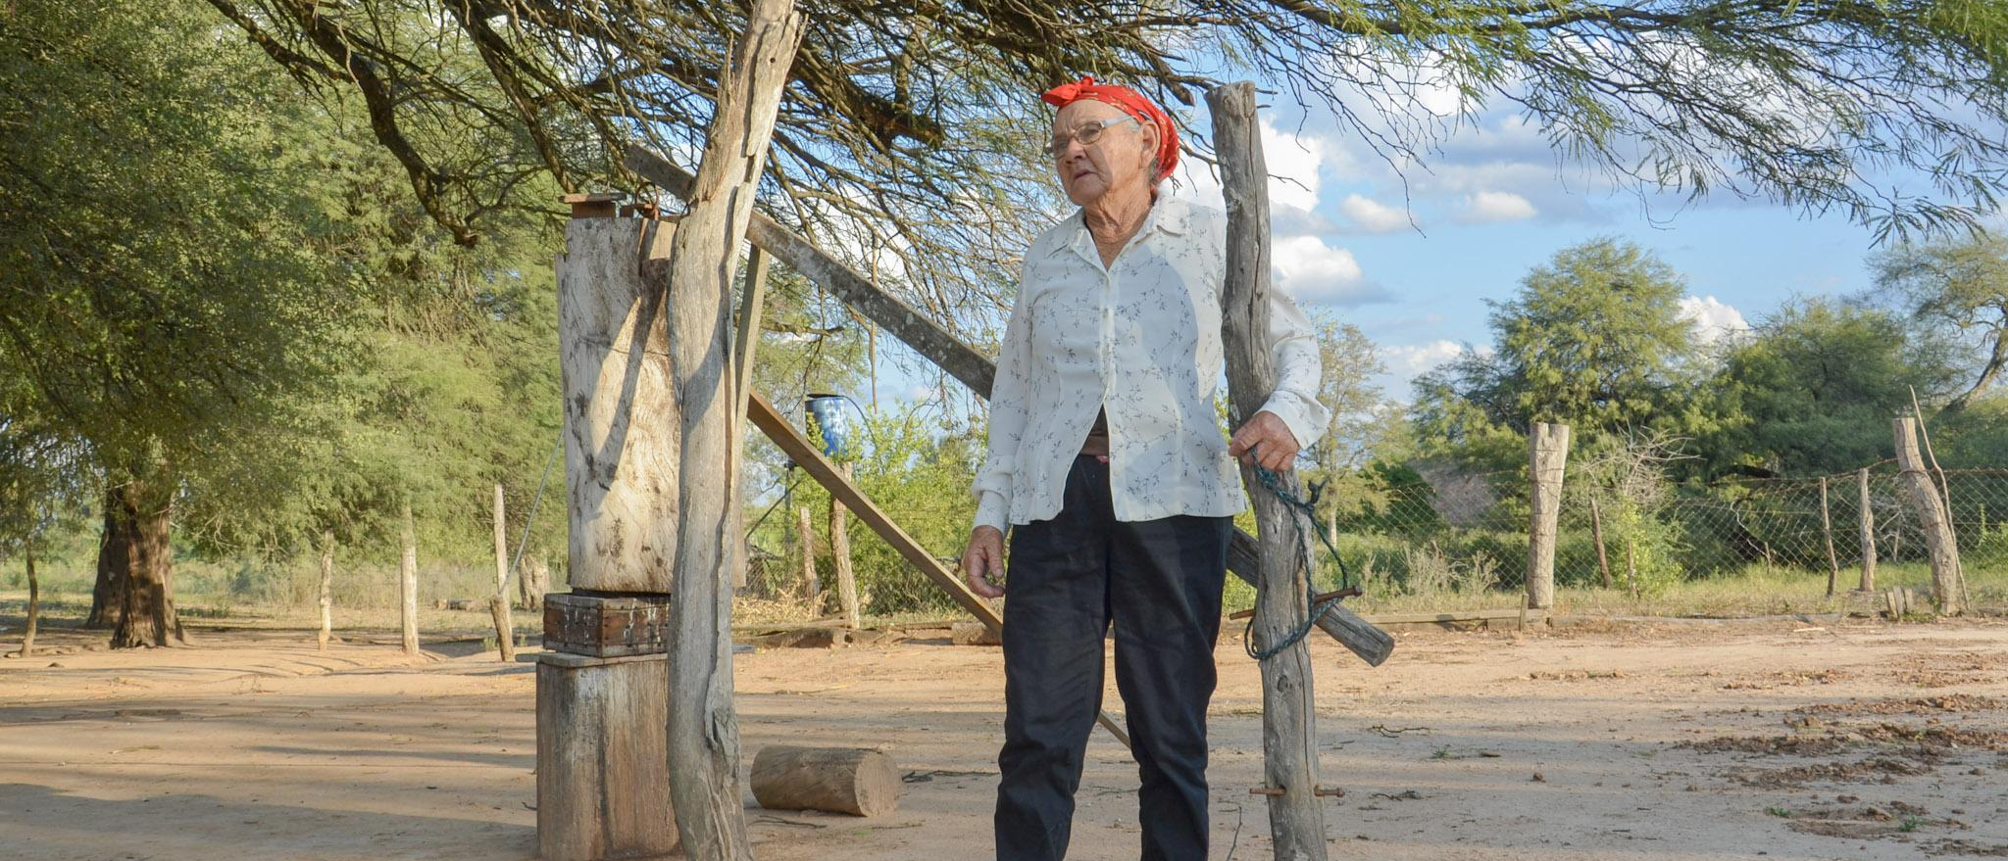
What kinds of support can businesses provide outside their value chains?
EXECUTIVE SUMMARY
Companies in different parts of the value chain can play different roles.
There are many actions that all companies can take whilst engaging with governments and multi-stakeholder platforms but can also make valuable contributions depending on their position in the value chain. Financial institutions play a particular role in supporting and incentivising commodity transformation, whilst manufacturers, brands and retailers can help raise awareness and public buy-in, amongst other activities.
©️ UNDP Paraguay

Slide 16
What does engaging beyond value chains mean for different parts of a business?
EXECUTIVE SUMMARY
Many corporate functions have a role to play in supporting engagement.
Some actions are cross-departmental. To become a true pillar, your sustainability strategy needs a strong buy-in from leadership that gives the mandate to other departments to play their role.
Engaging beyond value chains takes time and commitment.
While engagement can take many different forms, the steps below illustrate a broad outline of a typical journey for a company or finance provider:
Define the scope of engagement and allocate resources,
Establish governance and coordination and build trust,
Implement and evolve interventions,
Monitor and evaluate your involvement,
Communicate and report on shared progress.
©️ World Cocoa Foundation

Slide 17
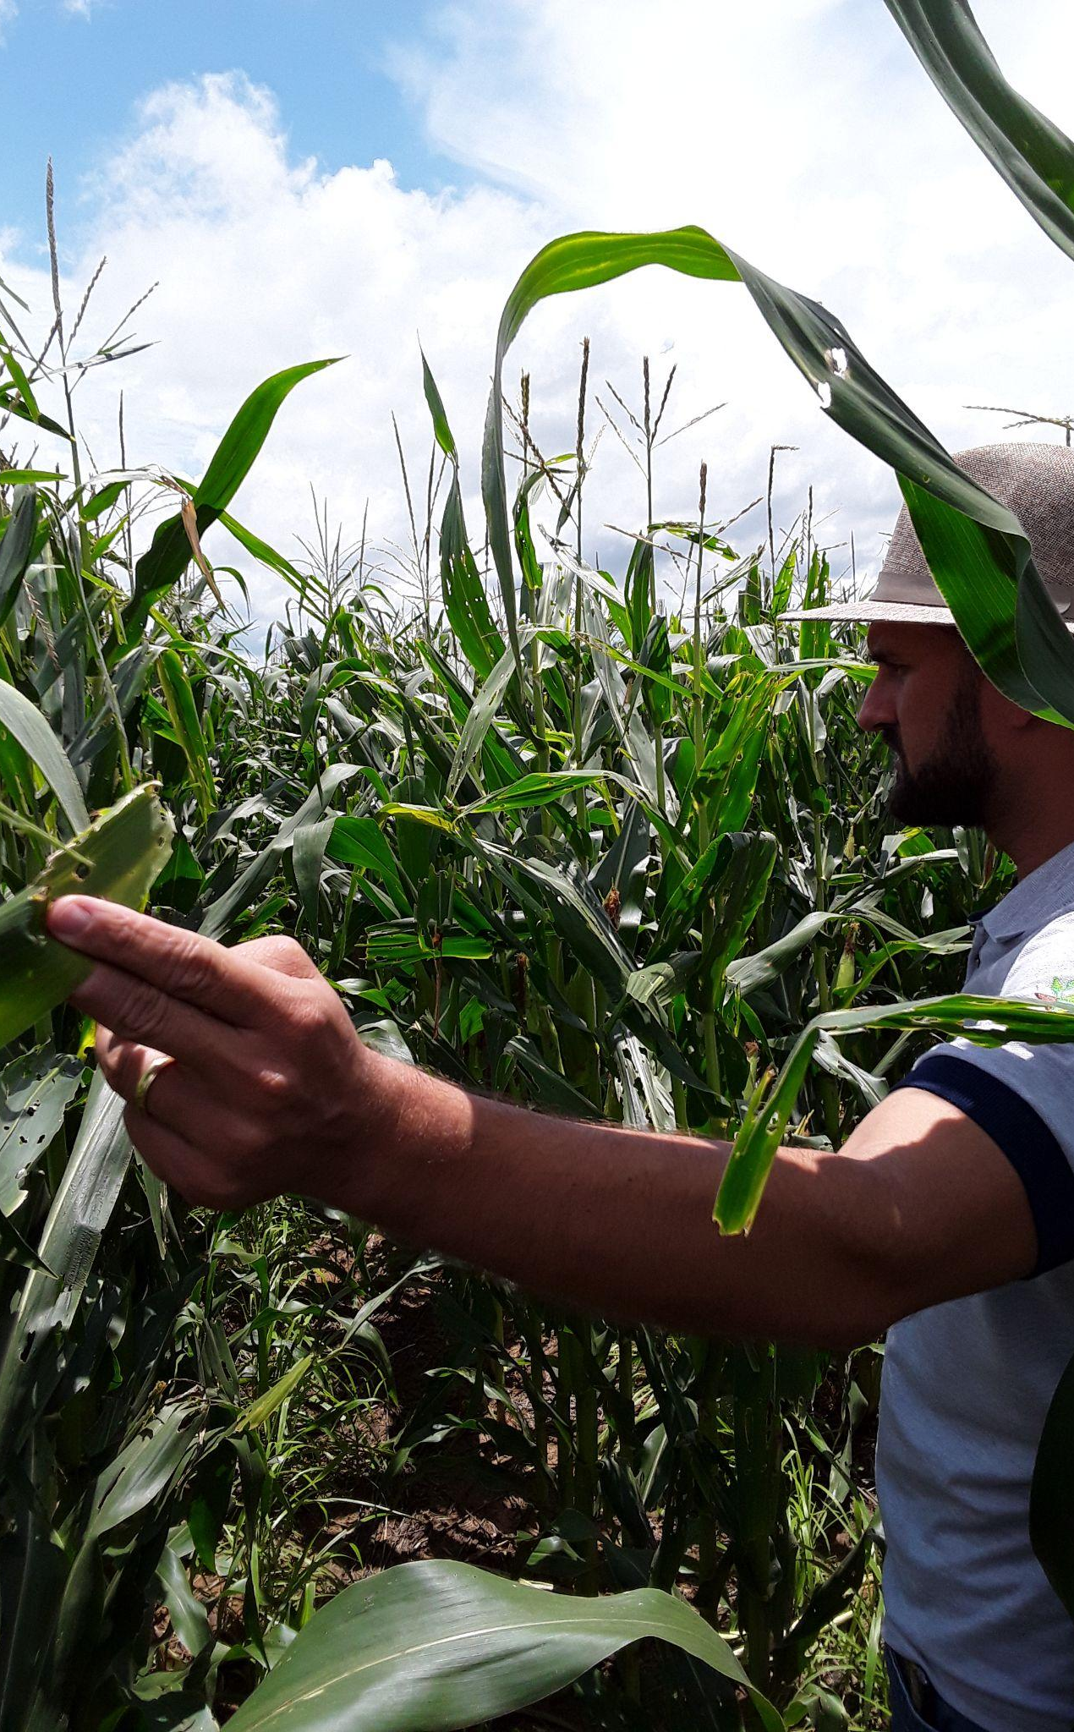
How does this all come together, and where can you go next?
EXECUTIVE SUMMARY
The Corporate Action Matrix helps build an approach to engagement.
Companies can use this matrix to identify the types of action that they can undertake at different levels and through what forms of interaction, to build a cohesive approach to engaging beyond value chains.
Where do I learn more, and find out what to do next?
This guidance note is just the start. There is a growing number of resources that can help businesses to answer questions about how to engage beyond their value chains, and to identify specific opportunities they can support.
©️ Henrique Paula

Slide 18
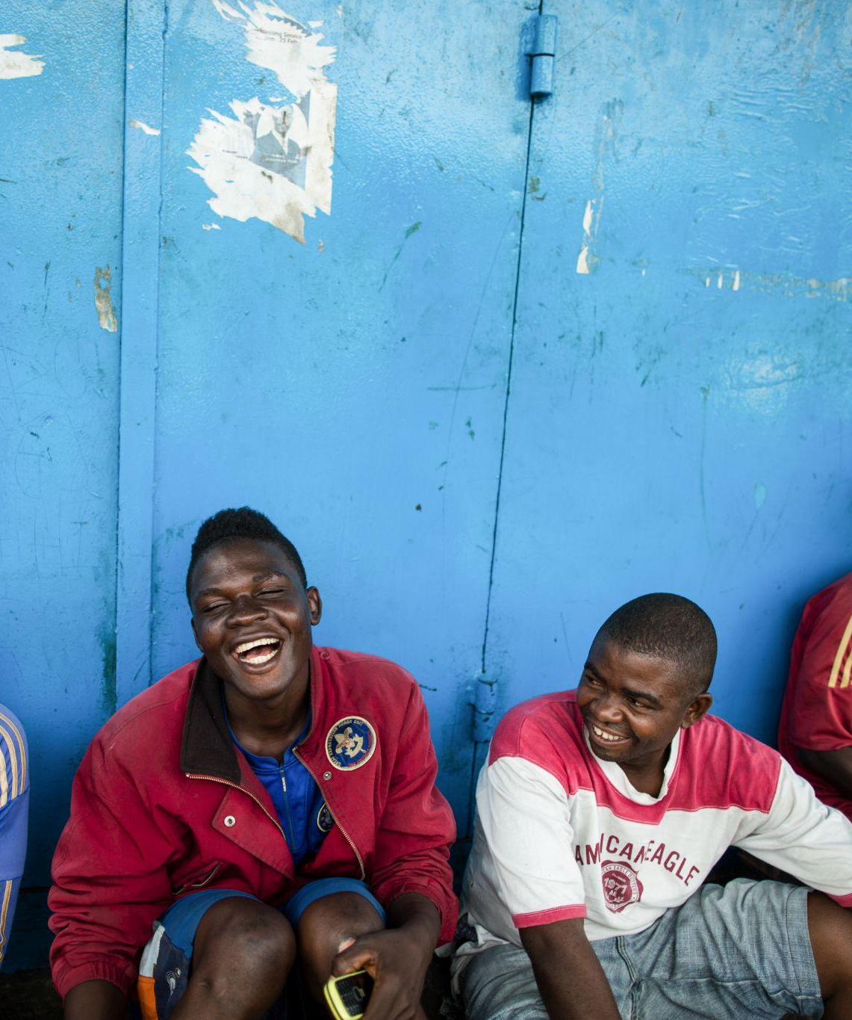
What examples of businesses or financial institutions collaborations can we refer to?
EXECUTIVE SUMMARY
…at different levels of government in Indonesia
National: Sustainable Palm Oil Platform (National Implementation Team)
Provincial: North Sumatra Platform (Provincial Implementation Team)
District: Siak Pelalawan
Landscape & Multi-scale: Coalition for Sustainable Livelihoods (CSL)
…working together beyond their value chains
Cocoa and Forests Initiative
Cerrado Working Group/Grupo de Trabalho do Cerrado (GTC)
The Soft Commodities Forum
Consumer Goods Forum (CGF) Forest Positive Coalition
…in different parts of the value chain
Producers: Wilmar International
Traders: Olam Food Ingredients
Manufacturers: Unilever
Retailers: Walmart
Finance: Rabobank; &Green Fund
The Value Beyond Value Chains Case Studies Collection provides more detailed case studies of organisations collaborating to promote systemic transformation in commodities production.
©️ UNDP Liberia

Slide 19
Why do we need transformation in commodities production?
©️ UNDP Paraguay

Slide 20
Unsustainable commodity production is creating major risks
Environmental and social challenges threaten food production globally, especially in tropical commodity producing landscapes and supply chains.
Producer poverty
Climate change
Human rights issues
WHY DO WE NEED TRANSFORMATION IN COMMODITIES PRODUCTION?
Biodiversity loss
Soil erosion
Pollution
Deforestation
Fresh water scarcity
Land degradation

Slide 21
Unsustainable commodity production is creating major risks
Climate change
Agriculture and food systems account for around a third of global greenhouse gas emissions, contributing to climate impacts such as extreme weather, flooding, droughts, wildfires, pests and diseases - further disrupting natural systems and reducing productivity.
Biodiversity loss
Agriculture drives around 80% of native habitat loss, and is the primary threat to 86% of the 28,000 species currently at risk of extinction.
WHY DO WE NEED TRANSFORMATION IN COMMODITIES PRODUCTION?
Pollution
Overuse of chemical fertilizers and pesticides in farming is polluting soils, contaminating water systems and the ocean, and damaging crucial biodiversity – including pollinators – which are essential to ecosystems and productivity.
Fresh water scarcity
Agriculture accounts for around 70% of global freshwater withdrawals (up to 90% in some economies) and on average is only replenished at around 60% the rate of extraction, leading to growing scarcity.

Slide 22
Unsustainable commodity production is creating major risks
Land degradation
A third of the world’s arable land has been degraded by agrochemicals and monoculture or lost to erosion in the last 40 years – yet global demand for food continues to rise.
Deforestation
Just seven agricultural commodities — cattle, oil palm, soy, cocoa, rubber, coffee and timber — accounted for 26% of global tree cover loss from 2001 to 2015. Loss of primary forest continues to increase, growing 12% between 2019 and 2020 despite the pandemic.
WHY DO WE NEED TRANSFORMATION IN COMMODITIES PRODUCTION?
Soil erosion
Human activity and land use change are the primary cause of accelerated soil erosion, with major implications for nutrient and carbon cycling and land productivity. Rates of soil erosion are predicted to rise by up to two thirds over the next 50 years.

Slide 23
Unsustainable commodity production is creating major risks
Human rights issues
Commodity supply chains are a major source of exploitation. Around 70% of child labour globally is estimated to be in the agriculture sector. Indigenous Peoples and Local Communities are particularly vulnerable to expansion and displacement when their customary rights to land and resources are not respected.
WHY DO WE NEED TRANSFORMATION IN COMMODITIES PRODUCTION?
Producer poverty
Agriculture is critical to the economic growth of many developing and emerging economies. Of over 200 million smallholder farms operating in commercial supply chains, up to 139 million households are estimated to be below the median poverty line, and up to 54 million households in extreme poverty.

Slide 24
But overcoming these systemic challenges offers huge reward
Transforming tropical commodity production in landscapes and supply chains will ensure future productivity and security, improve livelihoods and protect crucial ecosystems and natural resources.
Climate mitigation
The world’s forests absorb around 7.6 billion tonnes of CO2e per year, 1.5 times more CO2 than the US emits annually. Avoiding deforestation and degradation could prevent up to 4.3–5.5 Gt CO2 being emitted into the atmosphere each year, helping to meet the goals of the Paris Agreement. Action to reduce deforestation could be more rapidly deployed than other mitigation strategies, which could reduce risks of rising future climate policy costs.
WHY DO WE NEED TRANSFORMATION IN COMMODITIES PRODUCTION?
Climate adaptation
Forests play a crucial role in climate change adaptation efforts. They act as a food safety net for local and Indigenous communities during climate shocks, reduce risks from disasters like coastal flooding, and help regulate water systems and microclimates to ensure ecological balance.

Slide 25
But overcoming these systemic challenges offers huge reward
Biodiversity conservation
Over 80% of the world’s terrestrial biodiversity can be found in forests. Preventing forest loss could ensure the survival of many species, and the ability of forests to provide essential ecosystem services such as clean air and water, healthy soils for agriculture, and climate regulation. This will be critical to meeting the goals of the Convention on Biological Diversity.
WHY DO WE NEED TRANSFORMATION IN COMMODITIES PRODUCTION?
Land restoration and regeneration
Restoring 150 million hectares of degraded agricultural land could generate $85 billion in net benefits, provide $30 billion to $40 billion each year in extra income for smallholder farmers and grow additional food for nearly 200 million people.
Sustainable livelihoods and poverty reduction
A study on the benefits of sustainability certification and standards for palm oil, coffee and cocoa producers has found improvements in income from the target commodity in 65% of the cases. Fairtrade certification is associated with higher output prices and higher incomes among smallholder farmers.

Slide 26
But overcoming these systemic challenges offers huge reward
Cost savings from ecosystems services
The economic value of forests is vast – one estimate suggests that the total value of intact forests and their ecosystem services is up to $150 trillion, around double the value of global stock markets. A total cost of $2.7 trillion for anti-deforestation measures and a further $3.5 trillion on restoration for the period 2030 to 2070 would save $33.5 trillion in economic costs.
WHY DO WE NEED TRANSFORMATION IN COMMODITIES PRODUCTION?
Socio-economic benefits
The sustainable management of forests could create $230 billion in business opportunities and 16 million jobs worldwide by 2030. The global organic farming market was worth $95.38 billion in 2020 and is expected to reach $151.36 billion in 2025, indicating growing demand for sustainable commodities. Transformation of the commodities sector could play a major role in helping to achieve many of the Sustainable Development Goals.

Slide 27
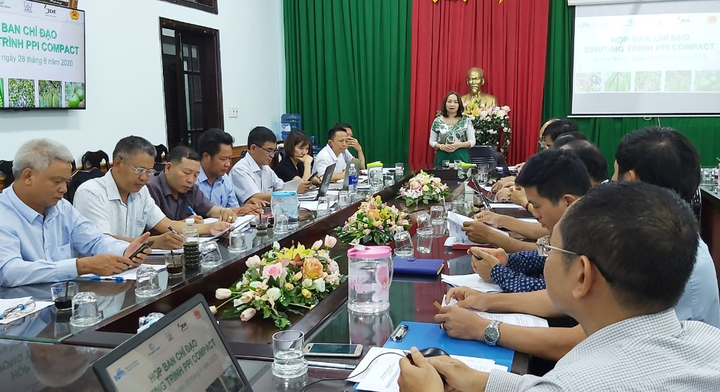
Why should companies and financial institutions engage beyond their value chains?
©️ IDH SourceUp

Slide 28
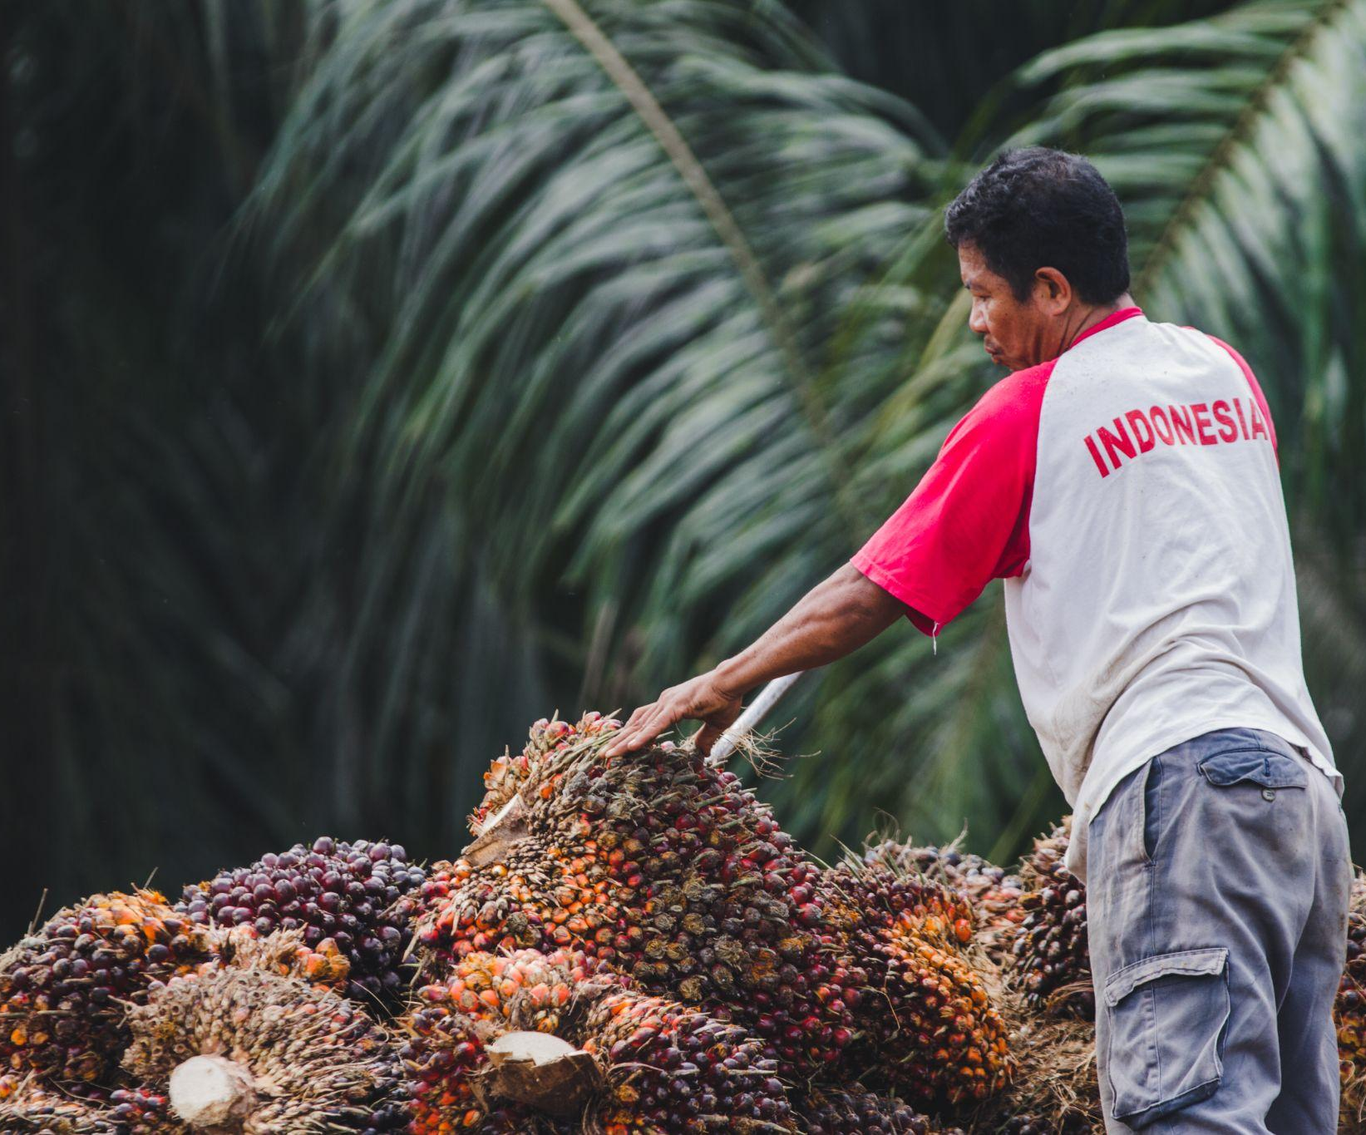
For companies, inaction carries both short-term and longer-term risks
Operational risks
Rapid action to address unsustainable production can protect revenue and reputation, while ensuring a stable operating environment. Reversing damage in future will be much more difficult and costly. ​
Brand and reputation
Deforestation, negative environmental impacts, poor labour conditions, and human rights abuses in supply chains are increasingly being exposed in campaigns which target retailers, manufacturers, traders and producers. This can cause major damage to brand reputation, leading to loss of demand, investment or employee talent - severely undermining business stability, reputation and future growth.
e.g., Campaign organisations such as Mighty Earth issue regular reviews of company performance that receive great attention from the international community.
License to operate
Markets and trade blocs are building tougher legislation and regulations for commodity imports associated with deforestation. The EU, UK and US are introducing import regulations with environmental and social requirements, to effectively ban commodity imports that cannot demonstrate compliance.
e.g., The US Customs and Border Agency banned imports from two Malaysian palm oil corporations in 2020 in response to evidence of human rights abuses. Major buyers followed by refusing to procure from them.
e.g., The Council of the EU adopted in June 2022 mandatory due diligence rules for all operators and traders who place, make available or export palm oil, beef, timber, coffee, cocoa and soy from the EU market to limit the consumption of products contributing to deforestation or forest degradation
WHY SHOULD COMPANIES AND FINANCIAL INSTITUTIONS ENGAGE BEYOND THEIR VALUE CHAINS?
Supply chain disruption
Trading bans, or crop failures from land degradation or climate change, can disrupt sourcing and cause ripple effects and loss of business across entire supply chains.
e.g., Repeated droughts in a major coffee producing region of Brazil, followed by an extreme cold spell in July 2021, led to a huge spike in the global price of coffee imports.
©️ UNDP Indonesia

Slide 29
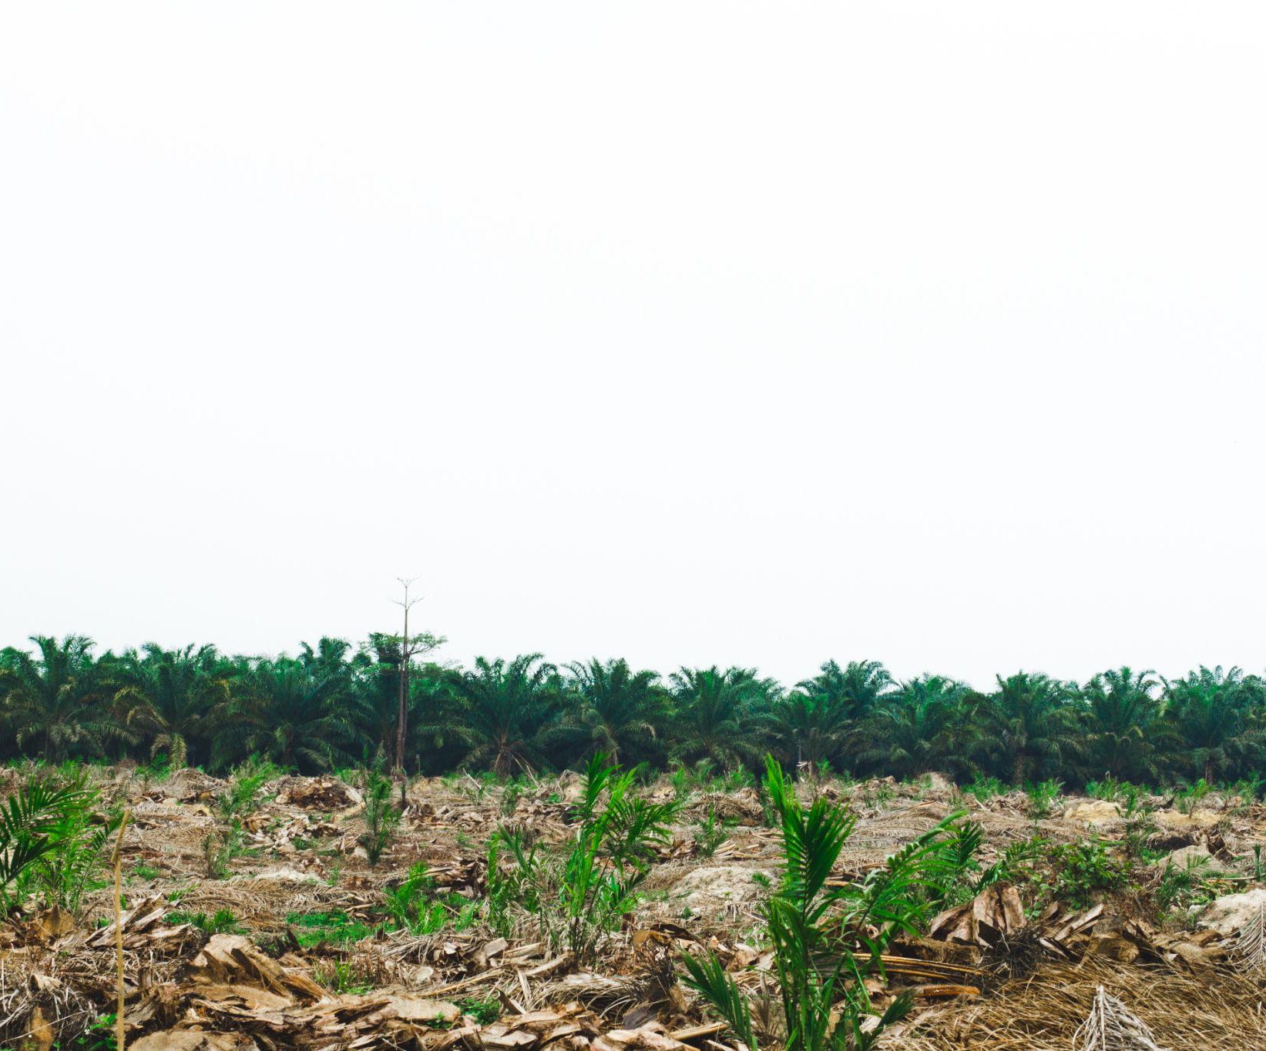
For companies, inaction carries both short-term and longer-term risks
Systemic risks
Rapid action to address unsustainable production can protect revenue and reputation, while ensuring a stable operating environment. Reversing damage in future will be much more difficult and costly.
Climate impacts
Transformation in the agriculture sector is essential to meet key goals of the Paris Agreement and Glasgow Climate Pact. Global agricultural productivity growth has already declined 21% since the 1960s as a result of climate change. Unless warming is kept below 2°C, productivity is expected to continue declining – creating systemic risks for the industry globally.
e.g., Yields are expected to decline most severely in tropical countries. Studies have shown that projected losses in the production of cacao and coffee threaten national economies and the regional and global supply chains of these industries.
Ecological instability
Commodity-driven deforestation and unsustainable farming practices are rapidly destroying the ecosystem services and natural resources our societies and economies depend on, while disrupting regional microclimates and increasing global climate vulnerability.
e.g., Pollination-dependent crops, such as coffee and cocoa, are valued 500% higher than crops that do not need pollination, yet overuse of pesticides is decimating pollinator populations around the world.
WHY SHOULD COMPANIES AND FINANCIAL INSTITUTIONS ENGAGE BEYOND THEIR VALUE CHAINS?
Livelihood damage & food insecurity
Increased incidence of crop failure and declining productivity threaten the livelihoods of producers globally, and contribute to growing food insecurity. Unless land degradation is reversed, competition over remaining productive land will marginalise smaller producers and push many into poverty. Global demand for food is expected to increase 50% by 2050, yet commodity price volatility risks market failure and unequal access to food.
e.g., Low yields and reduced availability of non-genetically modified (GM) soy in 2021 led to price increases for buyers and consumers in countries with regulations against GM.
© UNDP Indonesia/Agusriady Saputra

Slide 30
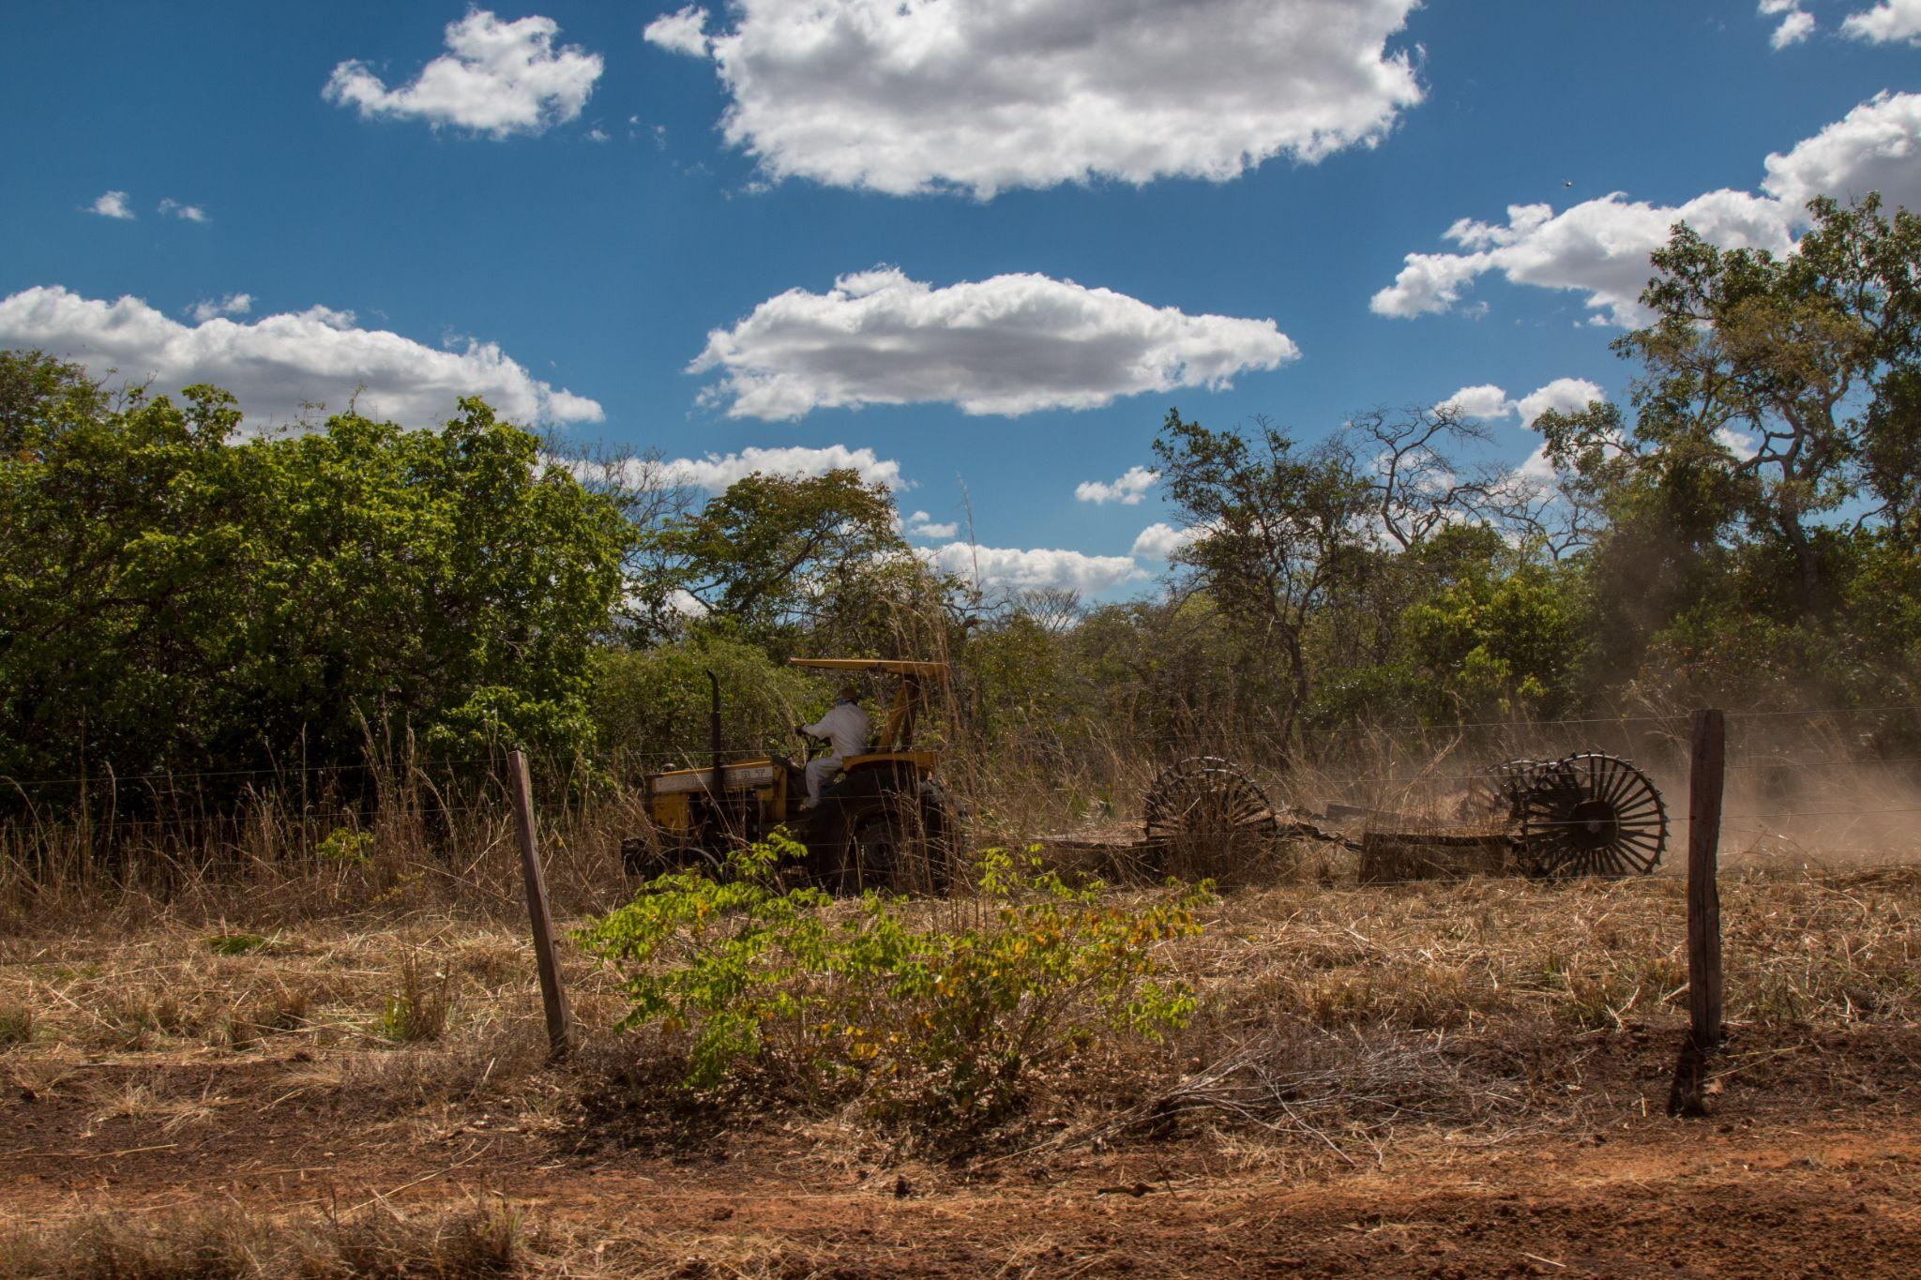
The drivers of unsustainable production are challenging to overcome
Commodity supply chains are extremely large and complicated. Multiple factors interact to create perverse incentives for unsustainably produced commodities.
These barriers are challenging for individual companies or financial institutions to address in their value chains for a number of reasons, including:
Differing legal and policy environments across value chains result in regulatory challenges and disconnects.
Unsustainable production practices receive public subsidies in many places, creating perverse incentives.
Many investors and traders prioritise short-term return on investment above long-term sustainability and resilience.
Tracing commodities back to farmers – and to production landscapes or jurisdictions – is difficult and costly.
Uncertified, unverified and illegal products can still get into the supply chain through illegality and corruption.
WHY SHOULD COMPANIES AND FINANCIAL INSTITUTIONS ENGAGE BEYOND THEIR VALUE CHAINS?
Providing technical training to farmers or financing conversion to sustainable production is costly.
There is limited data on the commercial business case for some sustainable commodities, which makes many companies or financial institutions reluctant to take action.
Buyers and consumers are prepared to pay little or no premium for sustainably certified products.
Low market penetration for sustainable agricultural commodities means that there are plenty of remaining markets for unsustainably produced commodities.
©️ Conservation International

Slide 31
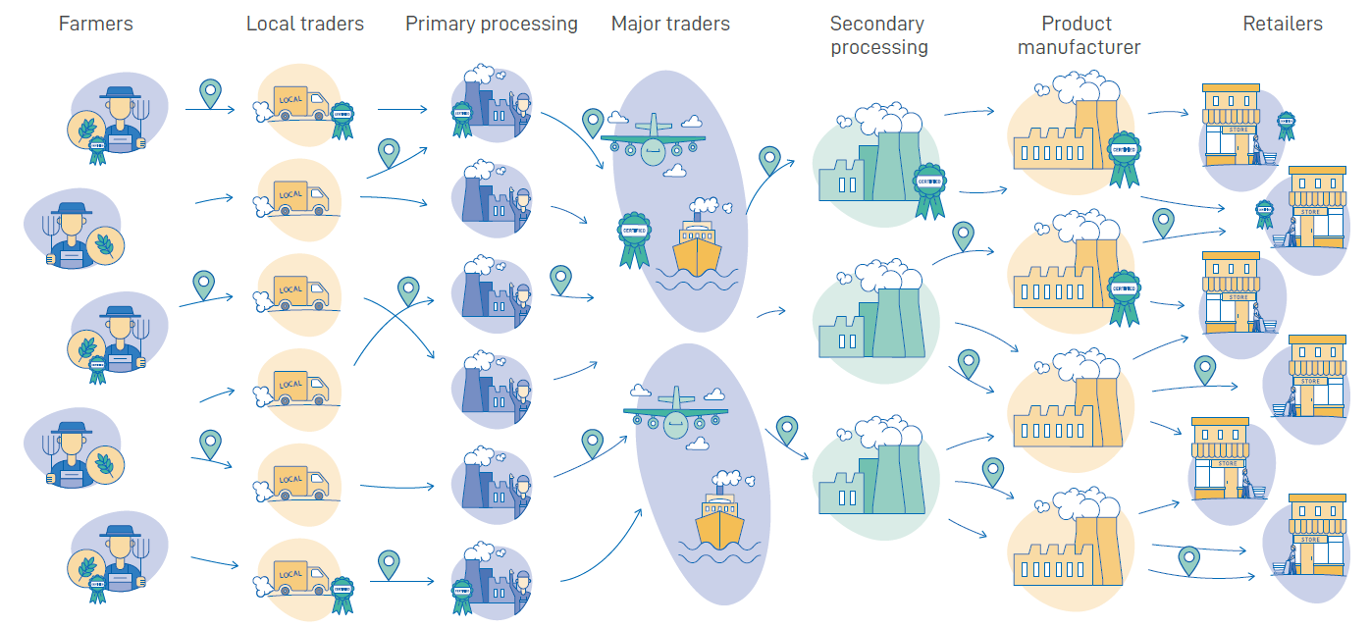
The drivers of unsustainable production are challenging to overcome
Global supply chain systems are complex, with underlying drivers related to policy, financing, and market demand, posing major challenges for companies and financial institutions seeking to improve commodity sustainability in their value chains.
Transforming the commodities sector towards sustainability will require collaboration and coordinated action to address barriers across different parts of the supply chain and at different levels of governance.
Engaging beyond value chains offers a key opportunity for companies and financial institutions to help accelerate the transformation needed.
WHY SHOULD COMPANIES AND FINANCIAL INSTITUTIONS ENGAGE BEYOND THEIR VALUE CHAINS?

Slide 32
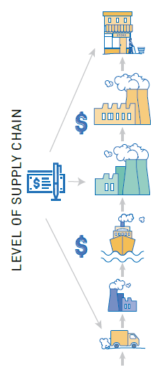
To drive transformation, companies must act beyond their value chains
Most existing action for sustainable commodities is focused on company operations and supply chains, leaving the enabling environment for sustainability unchanged.
Improving supply chain management is necessary but insufficient for solving the challenges of sustainable agricultural commodity production.
Many of the issues that need to be addressed are not under the control of a single producer, mill, aggregator or actor in the supply chain.
Addressing these issues requires action from multiple actors in the landscape including government, local communities, producers, civil society organisations and companies – requiring collaborative approaches within production landscapes.
Many companies do not have a clear understanding of how to do this.
2. Improve supply chain management
Implement sustainable sourcing policies
Map supply chains and trace products through supply chains
Implement certification systems
Pay a premium for certified products
Make purchasing commitments
1. Create global frameworks
Make global commitments (e.g., New York Declaration on Forests)
Develop sectoral sustainability standards (e.g., Roundtable on Sustainable Palm Oil)
Create common frameworks for action (e.g., Accountability Framework)
3. Support farmers
Support farmer organisations, farmer training, access to finance, replanting, certification
WHY SHOULD COMPANIES AND FINANCIAL INSTITUTIONS ENGAGE BEYOND THEIR VALUE CHAINS?
But, the enabling environment is not addressed
Farm
Landscape
Sub-national
National
Global

Slide 33
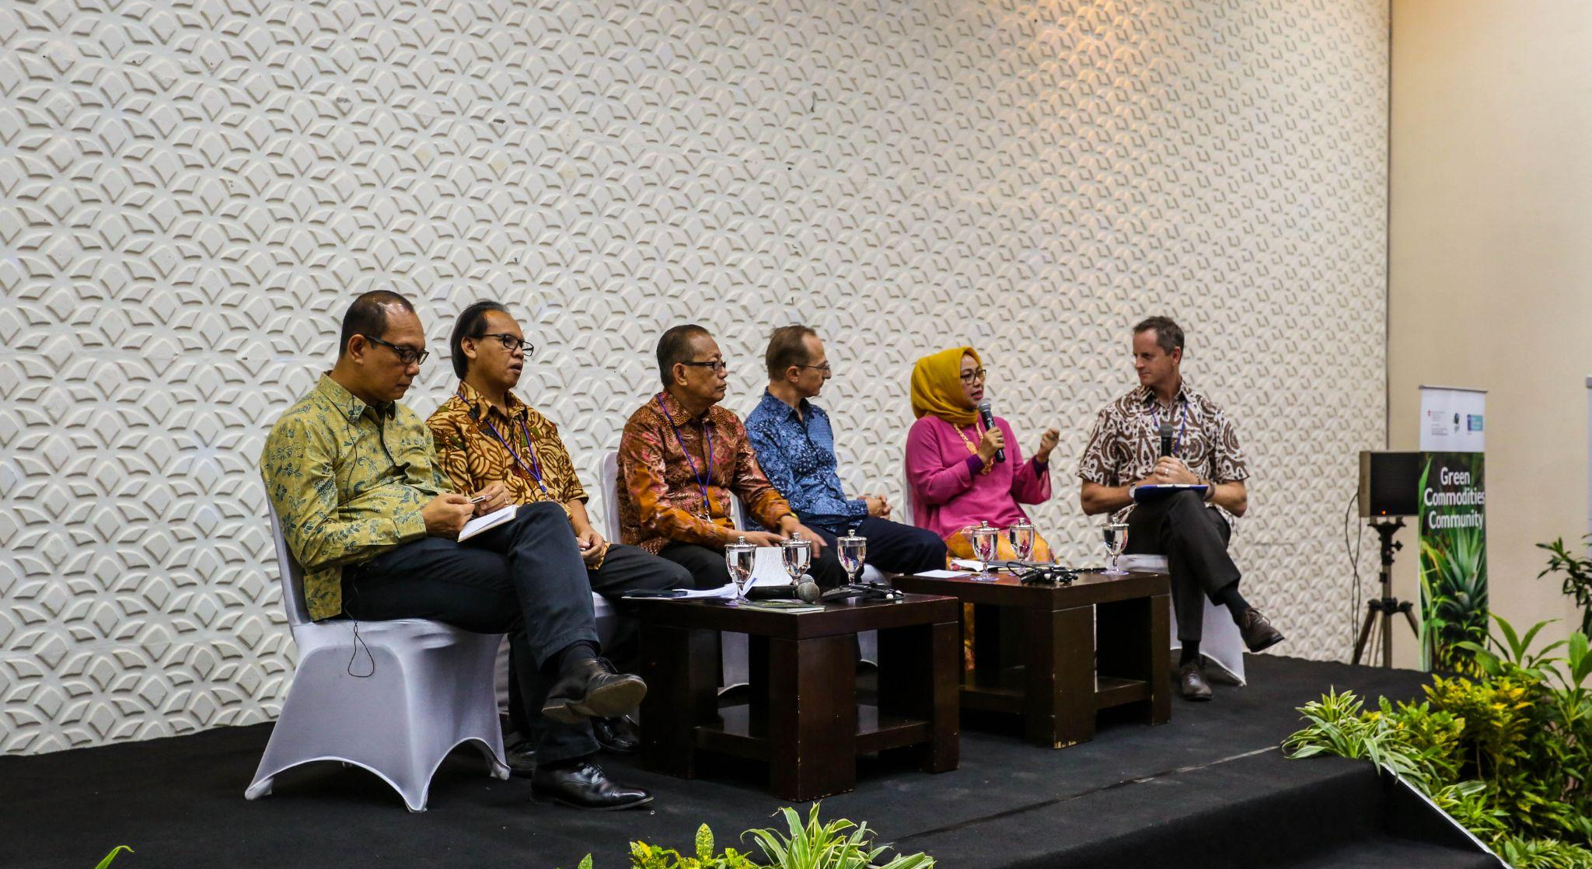
What value does engaging beyond value chains create?
© UNDP

Slide 34
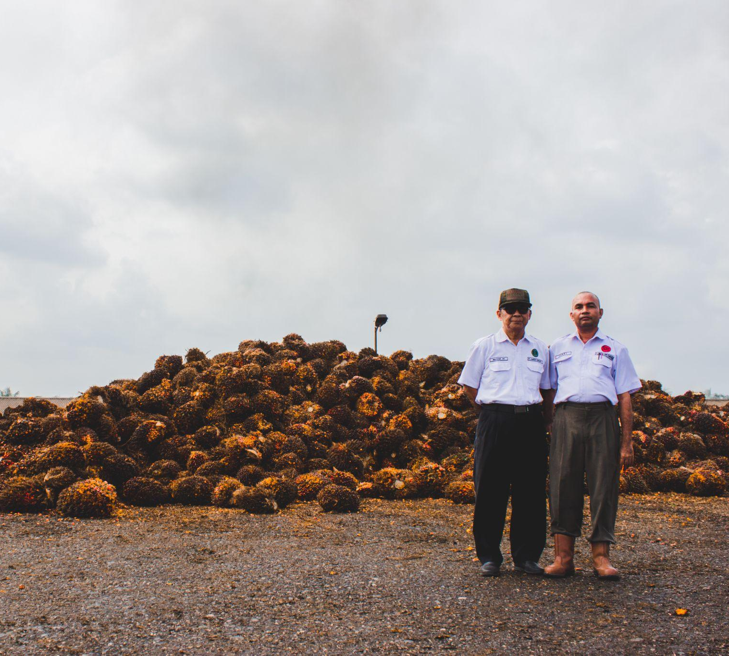
Addressing the enabling environment raises standards across the board
By working with governments to strengthen policy, enforcement and standards the enabling environment can turn good practice into standard practice and share the cost of sustainability between companies.
Achieving a sustainable agricultural system requires that standards are raised across the board – ‘raising the floor’ – which requires action to strengthen the enabling environment in commodity producing landscapes, regions and countries.
Collaboration between governments, producers and buyers can create incentives and enablers for sustainable production and demand across landscapes, jurisdictions and entire regions.
WHAT VALUE DOES ENGAGING BEYOND VALUE CHAINS CREATE?
© UNDP Indonesia/Agusriady Saputra

Slide 35
Addressing the enabling environment raises standards across the board
WHAT VALUE DOES ENGAGING BEYOND VALUE CHAINS CREATE?
Current reality: a two-tier production system
Islands of best practice.
Cost differences between legal minimums and industry best practice means that companies at the forefront risk being at a commercial disadvantage.
Production standards in some areas are improved, but bad practice is pushed elsewhere.
Underlying environmental and social issues remain because overall adoption of good practice remains low.
What is needed: raising standards across the board
Stronger laws and enforcement of higher minimum production standards to create more of a level playing field for all companies.
Reduced cost differential between legal minimums and industry best practice.
Sector wide capacity building.
Sector transformation across entire regions.

Slide 36
Collaborating to “lift the floor” supports long- and short-term priorities
As well as reducing operational and systemic risks that companies might face, engaging beyond value chains can increase access to finance, reduce costs & improve reputation.
WHAT VALUE DOES ENGAGING BEYOND VALUE CHAINS CREATE?
Supportive policy environment
Supply chain resilience
Investment and shared costs
Sustained growth
Risk mitigation
Priorities
Resilient sustainable production landscapes
Market demand
Business reputation
Trusted reputation with key stakeholders
Visibility and leadership

Slide 37
Collaborating to “lift the floor” supports long- and short-term priorities
Investment and shared costs
Companies or financial institutions can share transaction costs with partners, and benefit from increased investment in sector development and co-financing or donor funding.
WHAT VALUE DOES ENGAGING BEYOND VALUE CHAINS CREATE?
Trusted reputation with key stakeholders
Relationship building with internal and external stakeholders, alongside reputation as a sustainability leader, will increase trust and loyalty from investors, suppliers, buyers and consumers, strengthening market competitiveness and business resilience.
Visibility and leadership
Businesses or financial institutions can reap reputational benefits by delivering on Environmental, Social and Governance (ESG) targets or Sustainable Development Goals (SDGs); becoming a global Thought Leader, through brand profiling and the ability to tell a story about positive impact.

Slide 38
Collaborating to “lift the floor” supports long- and short-term priorities
Resilient sustainable production landscapes
Collaboration between companies and/or financial institutions can accelerate progress in delivering sustainability commitments and incentives – within companies and the broader sector. Greater resilience in your sector and sourcing regions will lead to risk reduction and market advantages.
WHAT VALUE DOES ENGAGING BEYOND VALUE CHAINS CREATE?
Supportive policy environment​
Companies or financial institutions can work with governments to build stronger legal and regulatory frameworks where they operate, creating a better environment for doing business and investing for the longer-term.

Slide 39
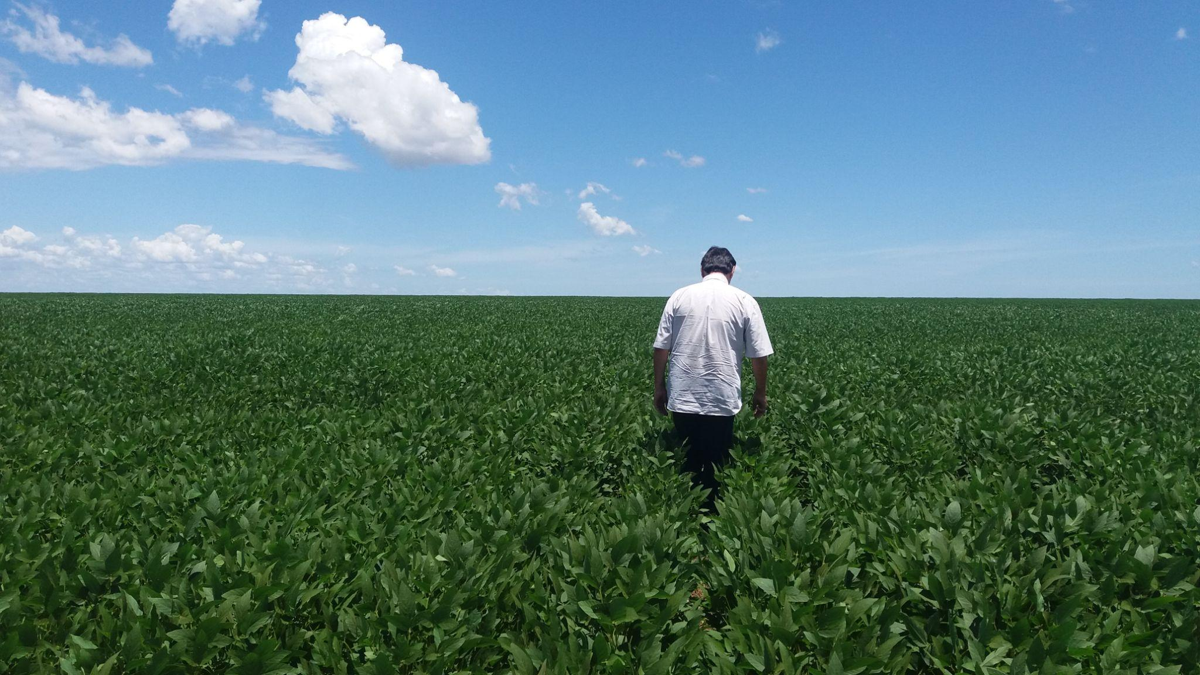
What does engaging beyond value chains mean in practice?
©️ UNDP Brazil/Iamilly Cunha

Slide 40
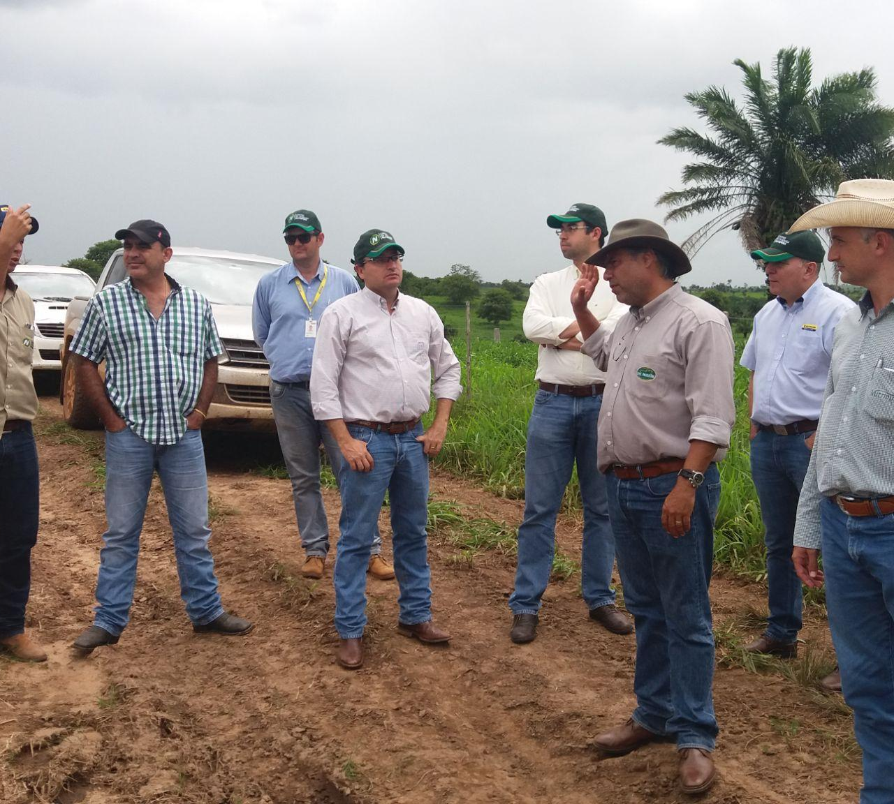
Companies can “engage beyond value chains” in several ways
Typically, engaging beyond value chains means working with other stakeholders, including governments, to define shared goals and develop action plans.
Engagement beyond the value chain involves collaboration with local or national governments, and working with other companies and stakeholders, in and beyond commodity producing regions.
This engagement can take many different forms, but will typically involve taking part in a coalition, a working group, a national or sub-national platform, a commodity roundtable, or another multi-stakeholder initiative.
WHAT DOES ENGAGING BEYOND VALUE CHAINS MEAN IN PRACTICE?
©️ Government of Mato Grosso

Slide 41
Key characteristics of a successful multi-stakeholder process/platform
Inter-ministerial government support: to secure the political backing for effective implementation of plans.
Facilitation: neutral convening organisations to facilitate and manage the process.
Inclusion: participation of the most important stakeholders, including a sufficient breadth of key stakeholders – including champions and, preferably, potential blockers.
Positive framing: aligning around a positive shared vision that politicians and other leaders can get behind.
Trust: multi-stakeholder forums can help to build relationships, shared understanding and trust, which are essential pre-conditions for effective collaboration.
Shared ownership: strong sense of joint ownership by government, private sector and civil society members.
Speed: moving slow enough to facilitate genuine stakeholder participation and fast enough to maintain momentum and reduce the risk from changes in the political environment.
Resilient process: designing processes that continue beyond political change, by building broad political support and ensuring the private sector and civil society also have strong shared ownership of the process.
Resourcing: ensuring the process is sufficiently resourced (money and people) and that key stakeholders have sufficient resources to participate.
Long term commitment: stakeholders need to have patience, persistence and commitment for the long term.
Producers
WHAT DOES ENGAGING BEYOND VALUE CHAINS MEAN IN PRACTICE?
International organisations
Buyers
Financial
institutions
Civil society
Governments

Slide 42
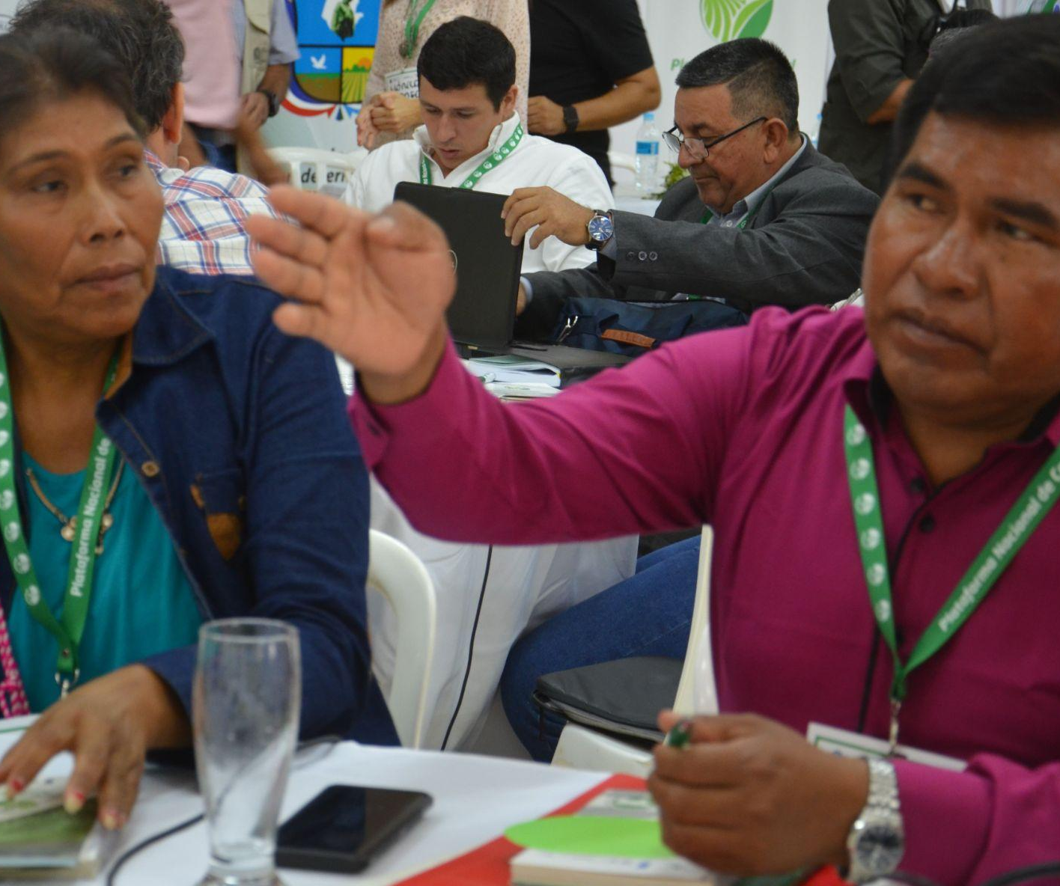
How to engage beyond value chains depends on where you are now
To understand your organisation’s ability to participate in multi-stakeholder processes at different level and get started, you should begin by asking:
How big is your company?
Will it have influence engaging with governments in production regions? Does it have resources to engage in multi-stakeholder processes?
Company size
Position in the value chain
What part of the value chain do you operate in?
What sub-sector is your company in? who are your key stakeholders?
WHAT DOES ENGAGING BEYOND VALUE CHAINS MEAN IN PRACTICE?
Which sourcing regions are strategically important?
Which are the most important production regions for the business operations, profits and growth of your organisation or portfolio companies?
Strategic
regions
What local presence and capacity do you have?
Is there already a local presence in the region; are you equipped to participate in a multi-stakeholder process directly or indirectly?
Capacity & presence
How mature is your sustainability strategy?​
Is the organisation still developing the ‘basics’ for sustainability within its own operations and value chain, or is it more advanced?
Maturity of
policy
©️ UNDP Paraguay

Slide 43
Organisations can choose their level of engagement
Decision-makers can prioritise which initiatives are most important to engage with – and can also choose their level of engagement according to their strategic priorities.
Examples of participation at varying levels include:
WHAT DOES ENGAGING BEYOND VALUE CHAINS MEAN IN PRACTICE?
High engagement
Convene coalitions of companies to participate in the process.
Lead or participate in technical working groups.
Lead coalitions of companies and/or financial institutions for public-private collaborations.
Deliver technical assistance.
Develop tailored products or services to support project goals.
Provide funding or investment for agreed actions or initiatives.
Medium engagement
Participate in plenary meetings.
Participate in coalitions that support the process.
Use advocacy and communications to provide public support for the process.
Encourage peer companies, suppliers and industry associations to participate.
Provide medium levels of funding or co-financing for agreed actions.
Low engagement
Provide feedback on documents published for consultation.
Contribute indirectly, for example via industry associations.
Monitor progress of the process and allow it to inform corporate strategy.
Provide low levels of funding or co-financing for supporting actions.

Slide 44
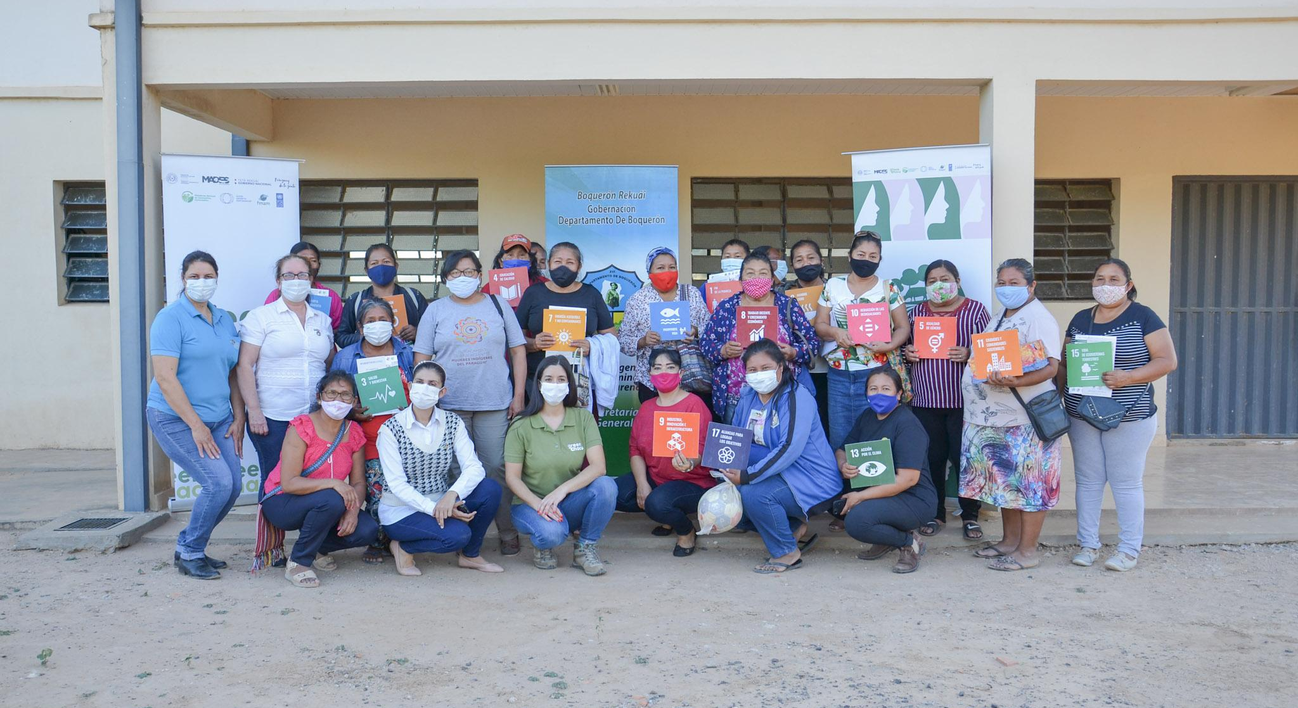
How can businesses and financial institutions engage with different levels of government?
©️ UNDP Paraguay

Slide 45
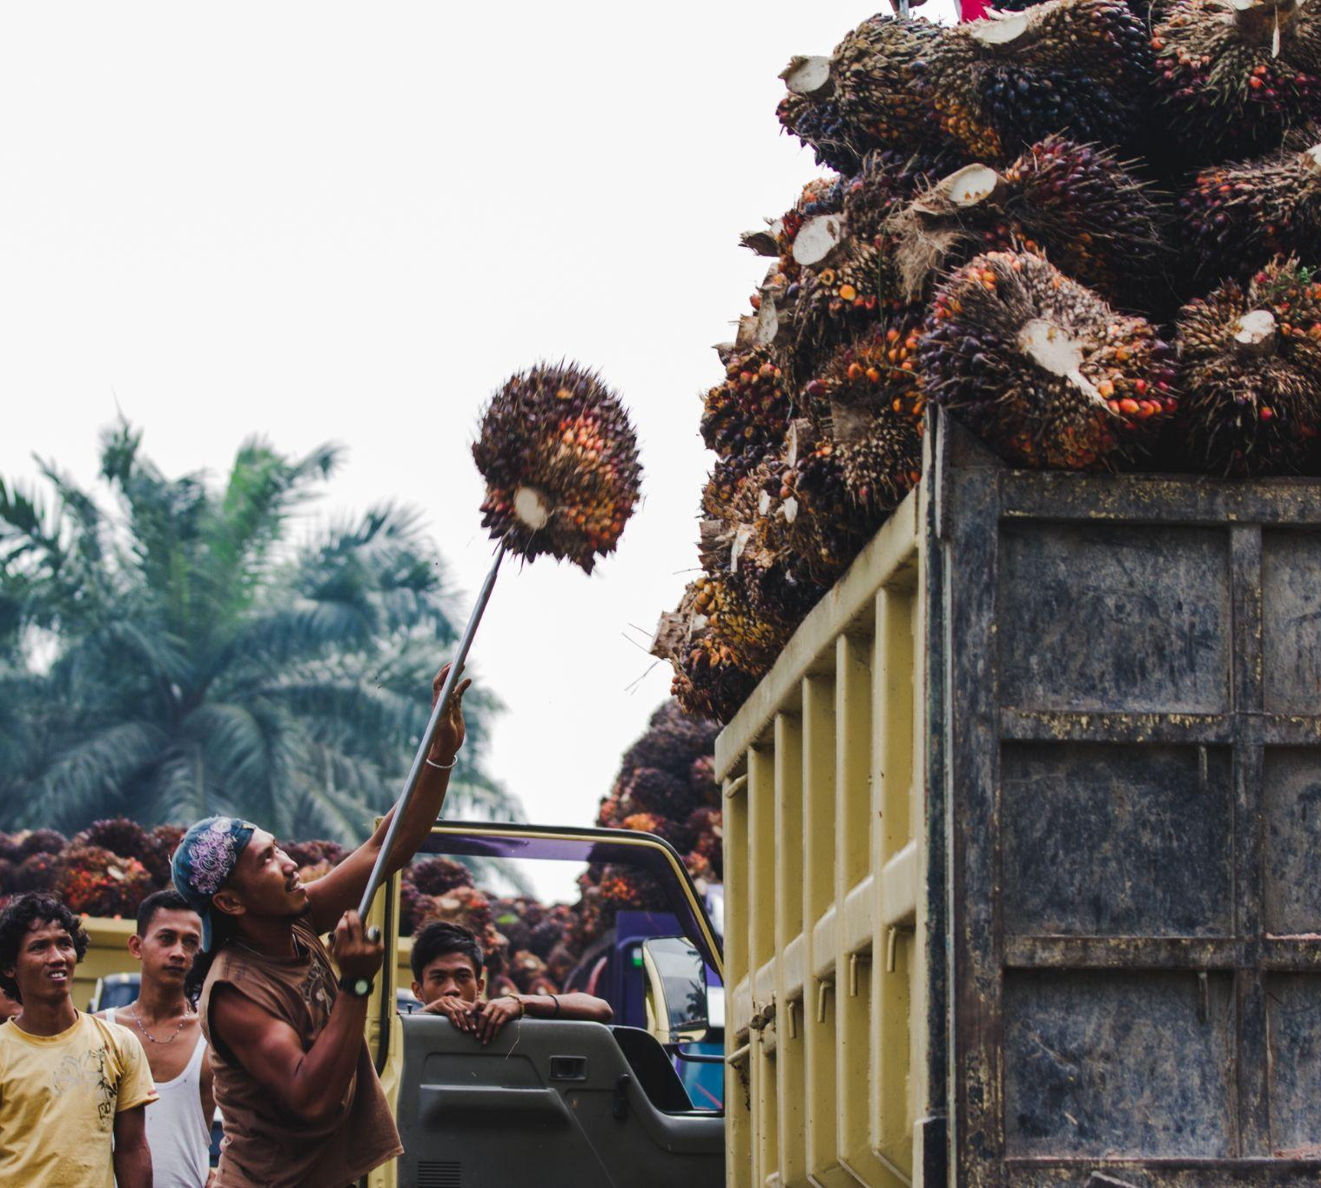
Companies can work with different levels of government…
Engagement at national level is a crucial aspect of engaging beyond value chains; national governments are responsible for critical aspects of the enabling environment and for setting the level of ambition in their countries.
National laws, policies and programmes create the frameworks within which any actions at sub-national and landscape levels take place.
Strong leadership at the national level creates an agenda that sub-national government can follow.
Conversely, without significant action at the national level, progress at the sub-national level is harder to achieve and sustain.
HOW CAN BUSINESSES AND FINANCIAL INSTITUTIONS ENGAGE WITH DIFFERENT LEVELS OF GOVERNMENT?
© UNDP Indonesia/Agusriady Saputra

Slide 46
Companies can work with different levels of government…
National level actions
Creating the enabling legal and economic environment, including strengthening of:
land tenure and ownership laws
land use planning laws and processes
environmental and labour laws and regulations
national production standards
national land use monitoring, enforcement and penalties
economic incentives for sustainable production
Aligning national commitments (including Nationally Determined Contributions (NDCs) and national biodiversity action plans), with international agreements such as the Paris Agreement and the Convention, Convention on Biological Diversity, and contributing to the Sustainable Development Goals.
Allocating of ministerial budgets to support sustainable production priorities.
HOW CAN BUSINESSES AND FINANCIAL INSTITUTIONS ENGAGE WITH DIFFERENT LEVELS OF GOVERNMENT?
Ensuring alignment across cross-cutting issues and different government ministries to create an enabling environment for economic and social development, such as: agriculture, environment, finance, infrastructure, business, health, education, and so on.
Accessing international donor funding for climate, forests, biodiversity.
Farm
Landscape
Sub-national
National
Global

Slide 47
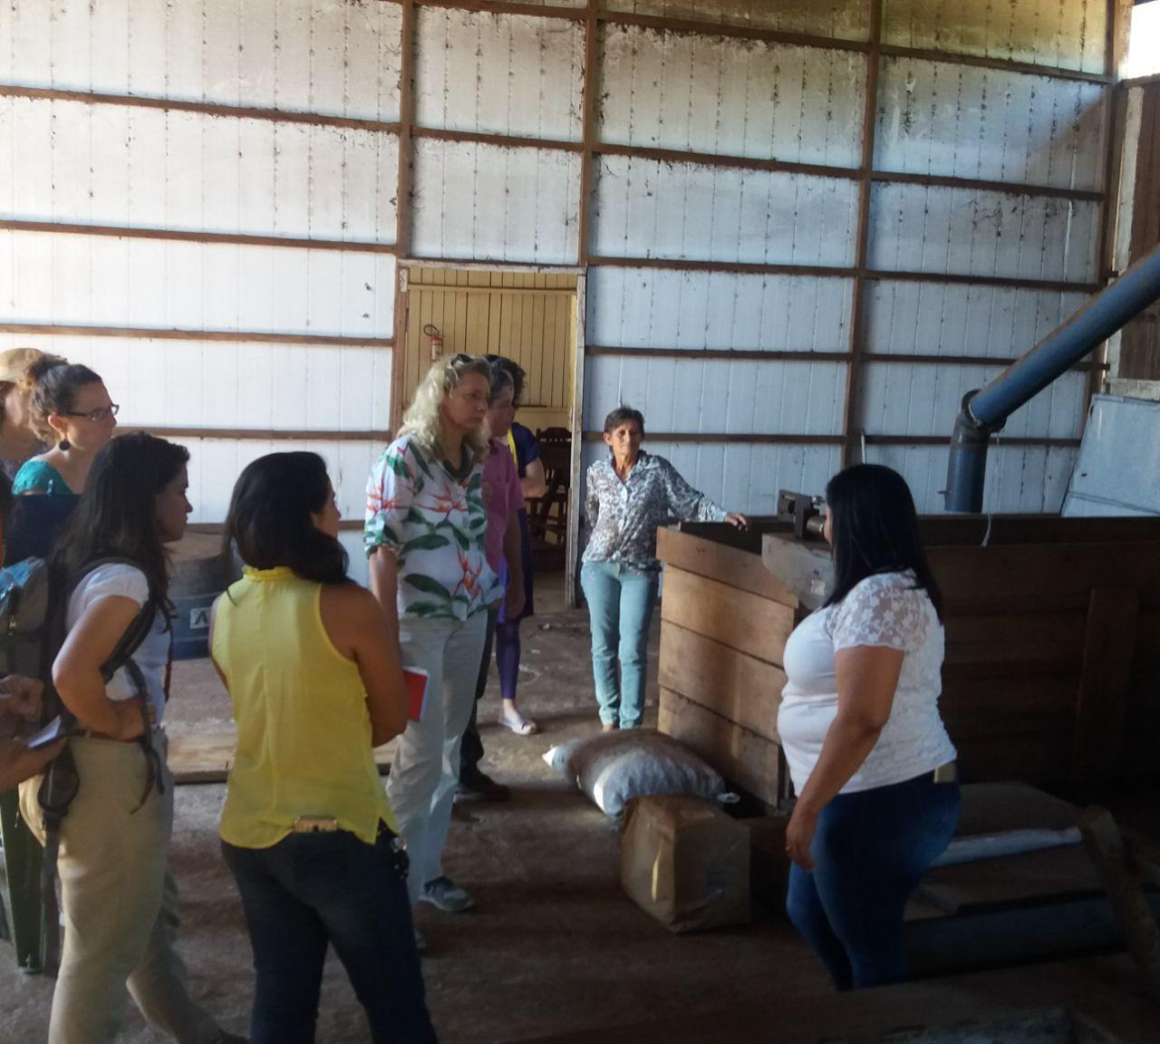
… and identify the right scale to work with according to needs
Sub-national landscape and jurisdictional initiatives are a central way through which companies can accelerate commodity transformation in key regions and sectors.
Integrated landscape initiatives can be relevant in cases where an important landscape cuts across administrative boundaries. Initiatives with an ecological landscape or ecoregion focus can address and tackle landscape management in more detail than is possible at jurisdictional scale, especially when only part of a landscape falls within political boundaries.
Provincial or state level government may be responsible for regional economic development planning and systems. Building new jurisdictional-scale enablers, including climate finance mechanisms and other accountability or finance tools, may be appropriate at this state or provincial level to achieve efficiencies of scale.
Detailed planning and enforcement typically happens at the more local district or municipal level.
HOW CAN BUSINESSES AND FINANCIAL INSTITUTIONS ENGAGE WITH DIFFERENT LEVELS OF GOVERNMENT?
©️ Government of Mato Grosso

Slide 48
… and identify the right scale to work with according to needs
Sub-national level actions (provincial/state and municipality/district):
Landscape level actions:
At each level of sub-national government:
Creating economic and regional development plans
Regional and local land use planning and land use monitoring
Aligning across the agendas of different departmental areas of government
Aligning regional and local government budgets with sustainable production priorities
Delivery of government extension services for farmer training and support
Cross-commodity perspective
Landscape management, addressing inter-dependencies at the level of the bioregion
Community development
HOW CAN BUSINESSES AND FINANCIAL INSTITUTIONS ENGAGE WITH DIFFERENT LEVELS OF GOVERNMENT?
Farm
Landscape
Sub-national
National
Global

Slide 49
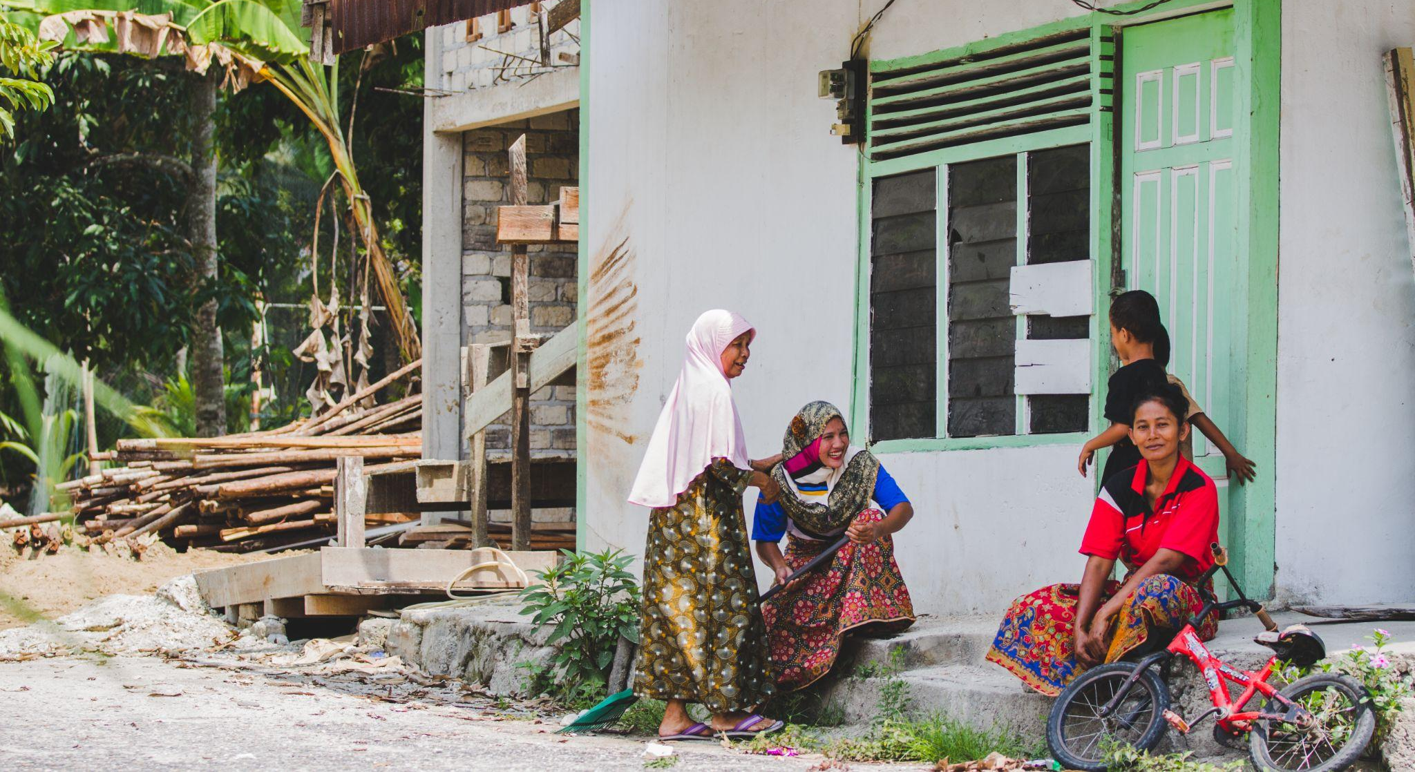
What kinds of support can businesses and financial institutions provide outside their value chains?
© UNDP Indonesia

Slide 50
Companies can support multiple aspects of the enabling environment
Underpinned by coordination and collaboration, companies can work directly with governments and other stakeholders according to the specific sustainability needs.
Better production practices Deliver more systemic solutions to improve production practices and farmer support.
Stronger land use governance Support improved land use governance and regulation to ensure sustainable land use.
WHAT KINDS OF SUPPORT CAN BUSINESSES AND FINANCIAL INSTITUTIONS PROVIDE OUTSIDE THEIR VALUE CHAINS?
Coordination and collaboration
Improve communication, relationship building, information sharing, and collaboration – between companies, governments, and other commodity stakeholders – across the sector and across the region.
Support community development Deliver long term solutions for social and economic development at community and landscape levels.
Improved conservation Improve conservation policy, enforcement, and strengthen incentives and funding mechanisms.

Slide 51
Companies can support multiple aspects of the enabling environment
Coordination and collaboration
Improve communication, relationship building, information sharing, and collaboration – between companies, governments, and other commodity stakeholders – across the sector and across the region.
Improve coordination and alignment between different initiatives with shared goals.
Increase transparency and accountability of initiatives across the sector.
Reduce duplication, dilution of effort and confusion.
Identify opportunities for pre-competitive collaboration between companies and for public private collaboration.
Facilitate more ambitious multi-party partnerships that can deliver long-lasting sectoral capacity building.
Encourage increased policy coherence between different ministries and different levels of government (national, provincial, local).
Signal support and commitment to important communities and sectors through longer-term agreements.
WHAT KINDS OF SUPPORT CAN BUSINESSES AND FINANCIAL INSTITUTIONS PROVIDE OUTSIDE THEIR VALUE CHAINS?

Slide 52
Companies can support multiple aspects of the enabling environment
Stronger land use governance
Support improved land use governance and regulation to ensure sustainable land use.
Support strengthening of sector governance.
Participate in land use planning and spatial zoning processes.
Support community-based resource management.
Map and prioritise ecological hotspots and high risk producers and landscapes.
Share data on land-use change.
Support smallholder and community land rights and resource access.
Collaborate on traceability systems.
WHAT KINDS OF SUPPORT CAN BUSINESSES AND FINANCIAL INSTITUTIONS PROVIDE OUTSIDE THEIR VALUE CHAINS?
Improved conservation
Improve conservation policy and their enforcement, and strengthen incentives and funding mechanisms.
Create compensation mechanisms for farmers, such as ‘payment for ecosystems services’.
Pool funding and resources for conservation.
Collaborate on environmental and biodiversity. impact assessments and landscape level plans.
Share data on ecological hotspots.
Align and partner with international climate finance providers and donor funding for conservation.
Provide technical assistance and funding to strengthen government monitoring and enforcement agencies.

Slide 53
Companies can support multiple aspects of the enabling environment
Better production practices
Deliver more systemic solutions to improve production practices and farmer support.
Share research and knowledge on sustainable and climate smart production practices.
Collaborate on farmer environmental training.
Help to strengthen extension systems.
Collaborate to address access to finance for smallholder farmers.
Catalyse institutional, financial and technical innovation to address cross-sectoral issues.
Innovate new business models that enable sustainable production, inclusion and conservation.
WHAT KINDS OF SUPPORT CAN BUSINESSES AND FINANCIAL INSTITUTIONS PROVIDE OUTSIDE THEIR VALUE CHAINS?
Support community development
Deliver long term solutions for social and economic development at community and landscape levels.
Align community development support with local and regional development plans.
Build local government capacity and invest in local infrastructure and sector development.
Build durable institutions and funding mechanisms that outlive supplier relationships.
Develop alternative livelihood strategies by engaging to diversify production and reduce over-dependence on single crops, and helping communities find alternative and supplementary sources of income.

Slide 54
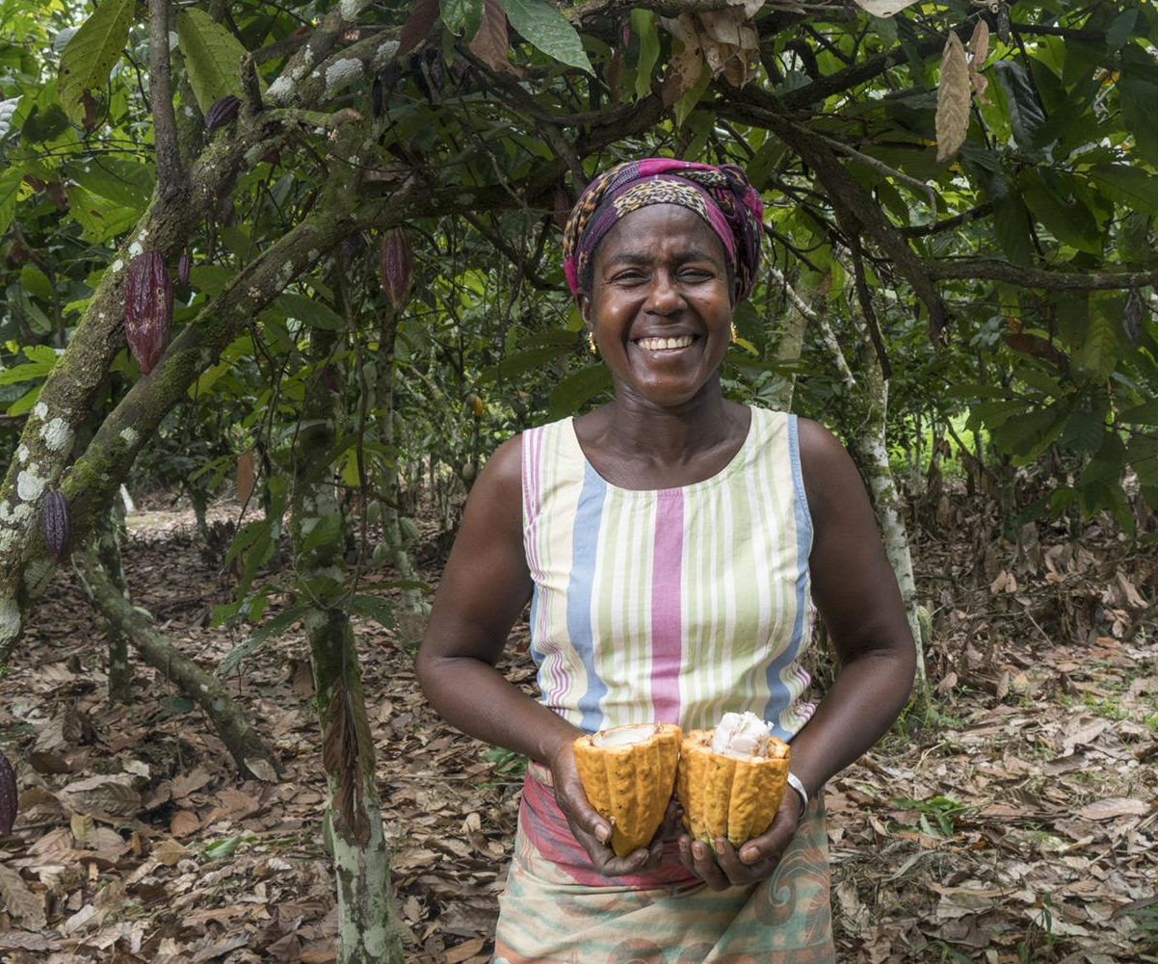
Engaging beyond value chains takes time and commitment
While engagement can take many different forms, these steps illustrate a broad outline of a typical journey for a company or finance provider:
Define the scope of engagement and allocate resources:
Select a strategic initiative to participate in, then agree the scope of your engagement and the financial and/or human resources required.
Define
Establish governance and coordination and build trust:
Decide who will represent and project manage, and who will participate in planning and decision-making with partners and stakeholders.
Establish
Implement and evolve interventions:
Coordinate timelines and deliver with other stakeholders and follow agreed steps for implementation; advancing your involvement in you choose to.
Implement
& evolve
WHAT KINDS OF SUPPORT CAN BUSINESSES AND FINANCIAL INSTITUTIONS PROVIDE OUTSIDE THEIR VALUE CHAINS?
Monitor and evaluate your involvement:
Develop Key Performance Indicators (KPIs) for your role, looking for shared indicators and targets with other partners and aligning these with the overall monitoring framework.
Monitor
& evaluate
Communicate and report on shared progress:
Collaborate with partners on shared messaging and strategic communications, aligning with a plan to amplify to your own audiences.
Report & communicate
©️ World Cocoa Foundation

Slide 55
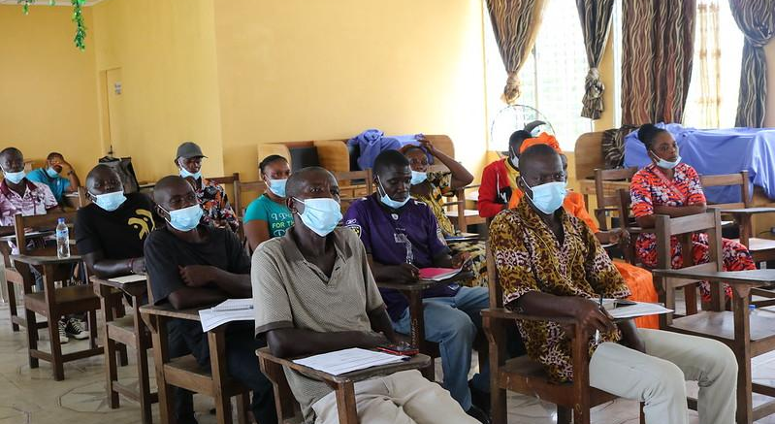
What does engaging beyond value chains mean for different parts of the value chain?
© UNDP Liberia

Slide 56
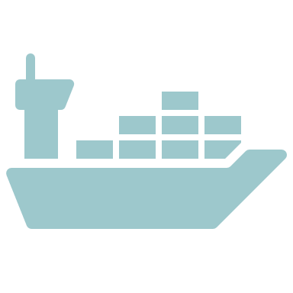
Companies in different parts of the value chain can play different roles
There are many actions that all companies can take whilst engaging with governments and multi-stakeholder platforms but can also make valuable contributions depending on their position in the value chain.
All companies or financial institutions
Participate in landscape, sub-national and national multi-stakeholder forums directly and/or through industry associations and corporate coalitions.
Support supply chain initiatives that align with multi-stakeholder forums in producer countries.
Align corporate objectives in sourcing regions with local and regional economic and community development objectives.
Agree common objectives Key Performance Indicators (KPIs) and reporting frameworks.
Develop and publish company action plans and progress reports.
Share company data that may be useful for the sector.
Support cross-sector initiatives.
Provide financial and technical support to multi-stakeholder forums.
WHAT DOES ENGAGING BEYOND VALUE CHAINS MEAN FOR DIFFERENT PARTS OF THE VALUE CHAIN?
Producers, primary processors & input providers
Ensure participation and views of smallholders are represented in multi-stakeholder forums.
Share company data – e.g., on farm mapping, conservation data, satellite monitoring of land use change.
Collaborate with peer companies and with government across landscapes for farmer support and community development.
Traders
Encourage producers to support and participate in multi-stakeholder forums.
Help producer groups understand market requirements and demand for social and environmental production standards.
Include environmental and social safeguards in contracts/ commodity specifications.
Commit to long term supplier relationships, including off-take agreements.
Capture sourcing and traceability data via monitoring and reporting systems to report to customers and national/global stakeholders.
©️ UNDP

Slide 57
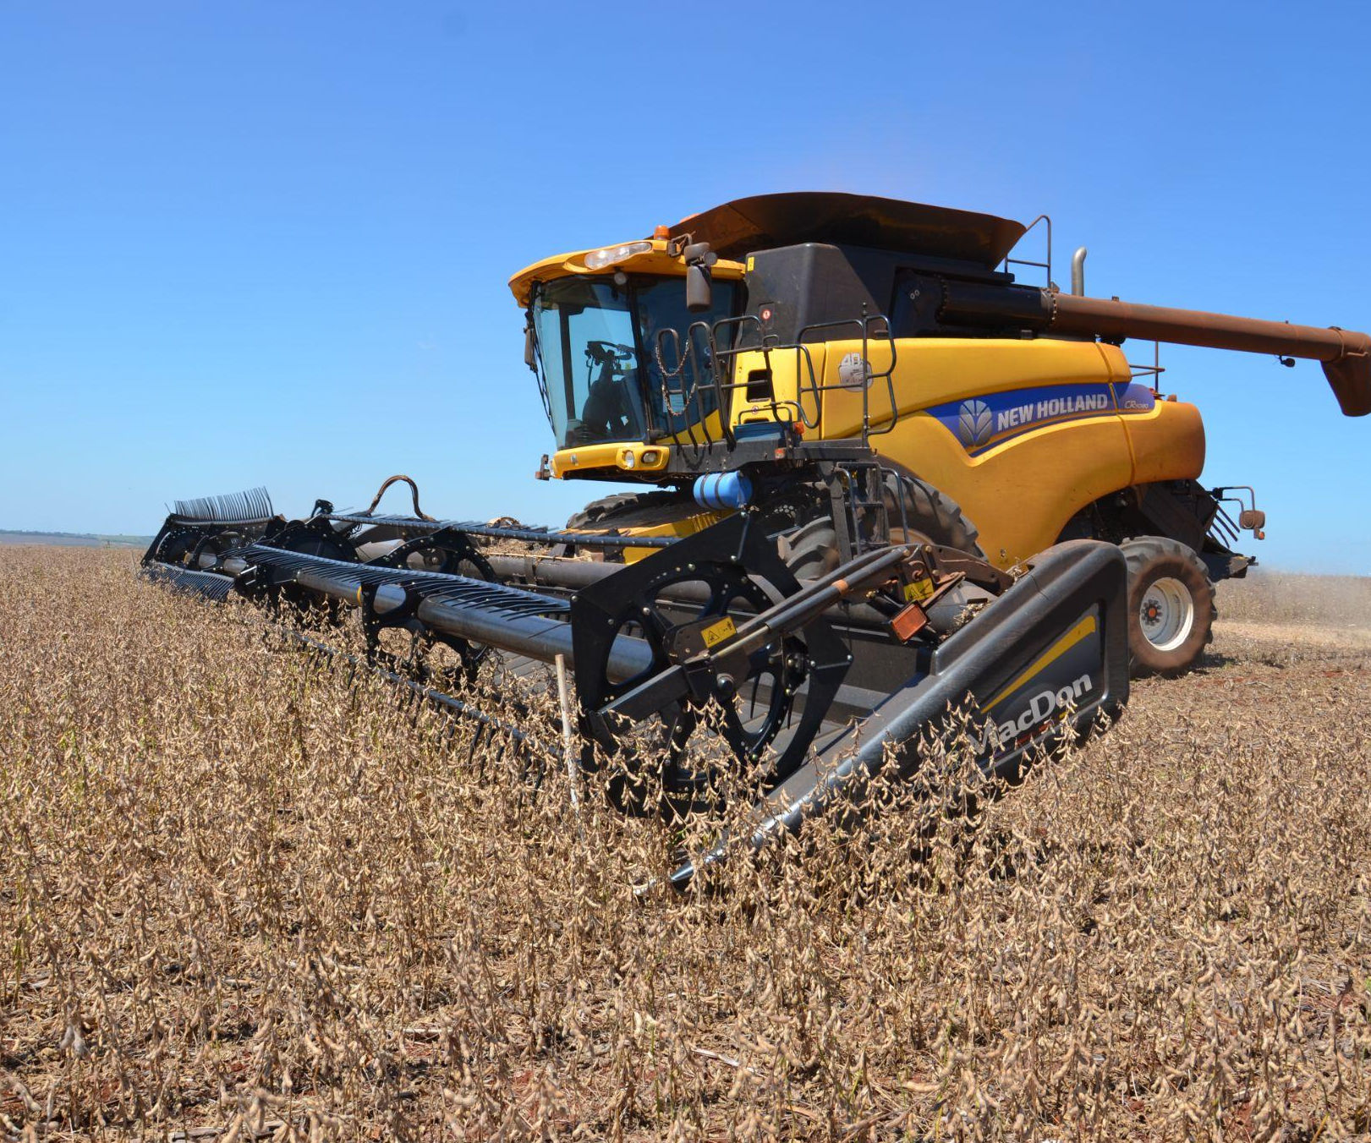
Companies in different parts of the value chain can play different roles
Financial institutions play a particular role in supporting and incentivising commodity transformation, whilst manufacturers, brands and retailers can help raise awareness and public buy-in, amongst other activities.
Finance
Provide technical expertise to inform national, sub-national and landscape level investment needs analysis.
Encourage participation by other financial institutions in multi-stakeholder forums.
Identify opportunities for the implementation of action plans.
Support financial innovation where it is required for the delivery of action plans.
Align lending policies and due diligence processes to sustainable commodity production principles.
Provide incentives to producers and supply-chain actors to implement sustainable production measures.
WHAT DOES ENGAGING BEYOND VALUE CHAINS MEAN FOR DIFFERENT PARTS OF THE VALUE CHAIN?
Manufacturers and ‘brands’
Encourage suppliers to support multi-stakeholder forums.
Prioritise critical sourcing regions and strategic commodities for direct participation in multi-stakeholder forums.
Actively support suppliers who are working to improve sectoral production standards and co-invest to deliver them.
Raise awareness with customers on the importance of creating the enabling conditions for sustainable production and the role of multi-stakeholder forums.
Preferential sourcing from origin countries and regions committed to continuous improvement and demonstrating progress, particularly where there is evidence of robust multi-stakeholder processes.
Retailers
Encourage suppliers to support and participate in multi-stakeholder forums.
Create pre-competitive collaborations to ensure that retailers are represented in multi-stakeholder forums in producer countries.
Incentivise suppliers (e.g., offering profile, providing access to opportunities, providing technical support) for pre-competitive collaboration and public private partnerships.
Raise the awareness of consumers of the importance on collaborating with producer governments to find long term solutions for sustainable production.
©️ UNDP Paraguay/Zunilda Acosta

Slide 58
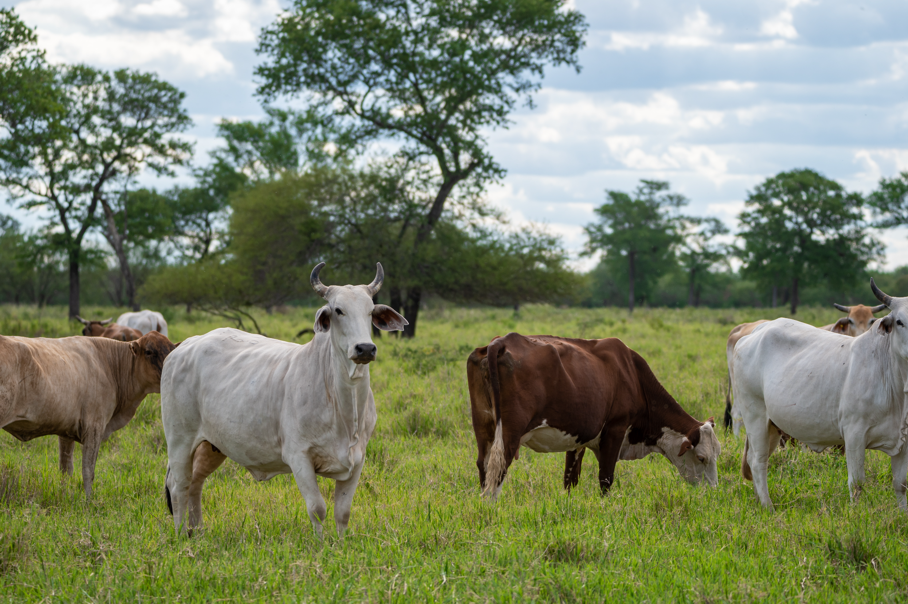
What does engaging beyond value chains mean for different parts of an organisation?
© UNDP Paraguay

Slide 59
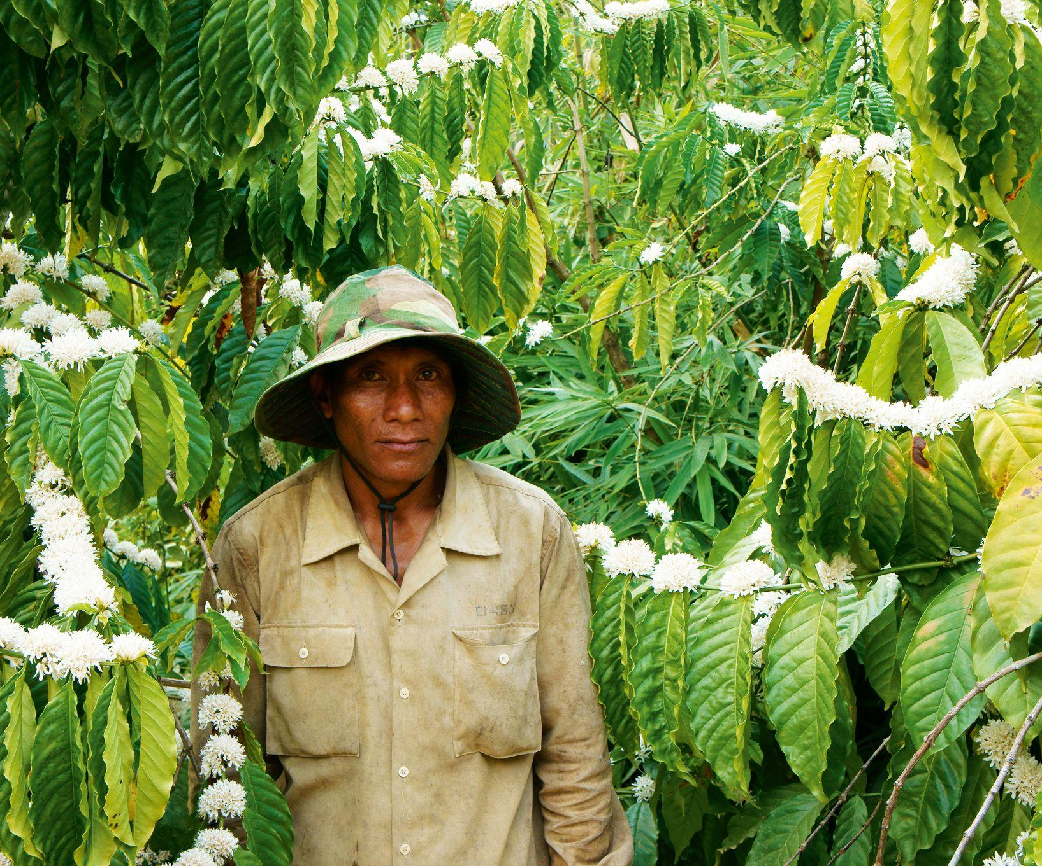
Many corporate functions have a role to play in supporting engagement
Some actions are cross-departmental. The roles played and actions taken by individual functions support and reinforce actions taken in other functions.
All departments
Contribute to planning the company’s involvement in multi-stakeholder initiatives.
Establish support and buy-in within your own function by presenting the value of engagement.
Communicate your department’s strategic priorities and challenges to ensure they are integrated into engagement plans.
Share data and insights as the company’s engagement progresses.
Sustainability & stakeholder engagement
Evaluate environmental and social risks for priority sourcing regions and identify regions for engagement in multi-stakeholder initiatives.
Mobilise pre-competitive collaborations and partnerships to support multi-stakeholder initiatives.
Develop corporate strategy for multi-stakeholder collaboration and identify other strategic implications, required human resources and investment needs.
Develop detailed business and investment cases, including identification of benefits, risks, costs, etc.
Provide ‘centre of excellence’ to support business units involved in implementation.
Monitor, aggregate and report results for multi-stakeholder initiatives the company participates in.
Marketing & communications
Communicate the importance of public private partnerships and pre-competitive collaboration to key internal and external stakeholder groups.
Educate and raise awareness among internal and external stakeholders about the need to move beyond unrealistic ideas of ‘silver bullet’ solutions to sustainable sourcing.
Share stories of multi-stakeholder initiatives and partnerships that are catalysing sector transformation.
WHAT DOES ENGAGING BEYOND VALUE CHAINS MEAN FOR DIFFERENT PARTS OF AN ORGANISATION?
©️ IDH Source up

Slide 60
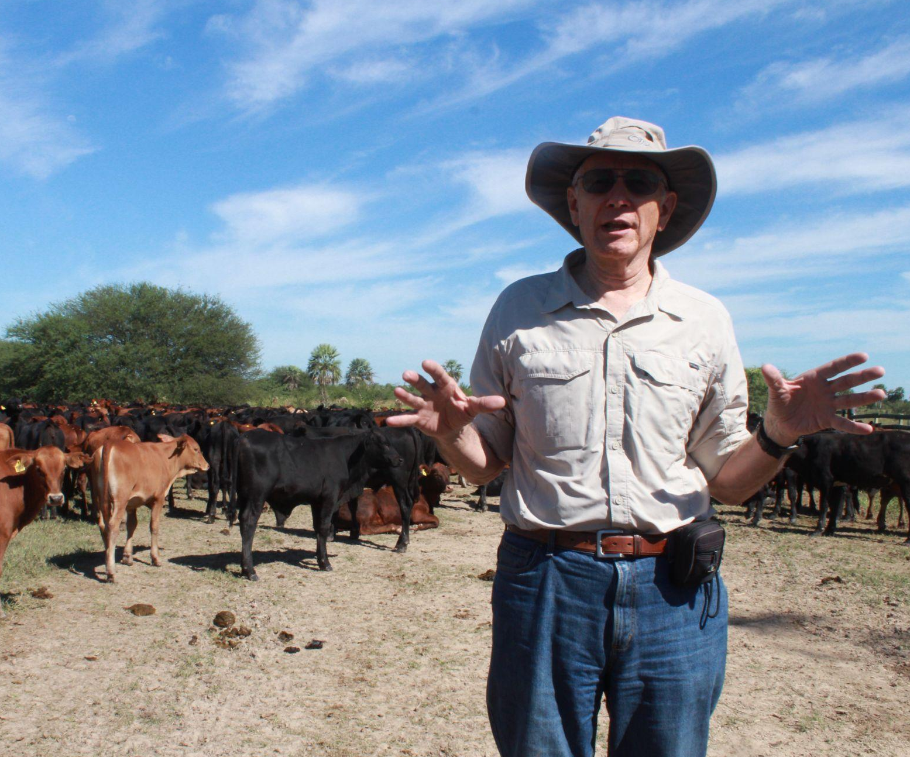
Many corporate functions have a role to play in supporting engagement
To become a true pillar of your sustainability strategy, strong buy-in is needed from leadership that gives a mandate to other departments to play their role.
C-Suite
Contribute to planning the company’s involvement in multi-stakeholder initiatives.
Establish support and buy-in within your own function by presenting the value of engagement.
Communicate your department’s strategic priorities and challenges to ensure they are integrated into engagement plans.
Share data and insights as the company’s engagement progresses.
Agronomy & farmer support
Deepen understanding of context in priority sourcing areas: barriers to sustainable commodity production, impact of procurement practices and local stakeholder actions, in order to feed into company plans, investments, reporting.
Contribute expert knowledge into multi-stakeholder forums directly or via industry associations and corporate coalitions.
Collaborate and coordinate on the ground with other actors working on same crop, issue or geographical area, who can share experience, technology, resources.
Share data on farm mapping, traceability, land use, training, etc.
Procurement
Align purchasing criteria to support the enabling conditions for sustainable production – e.g., preferential sourcing from regions that are demonstrating progress on sustainable production.
For priority sourcing regions, engage in multi-stakeholder forums either directly, with supply chain partners and/or through industry associations and coalitions.
Develop Key Performance Indicators (KPIs) for sustainable sourcing that include considerations around preferential sourcing from regions actively strengthening sustainable production.
Collaborate with other departments to ensure maximum leverage of purchasing power in negotiation with government.
Participate in partnerships with actors working on the same crop, issue or area, who can share experience, technology, resources.
WHAT DOES ENGAGING BEYOND VALUE CHAINS MEAN FOR DIFFERENT PARTS OF AN ORGANISATION?
©️ UNDP Paraguay/María Martinian

Slide 61
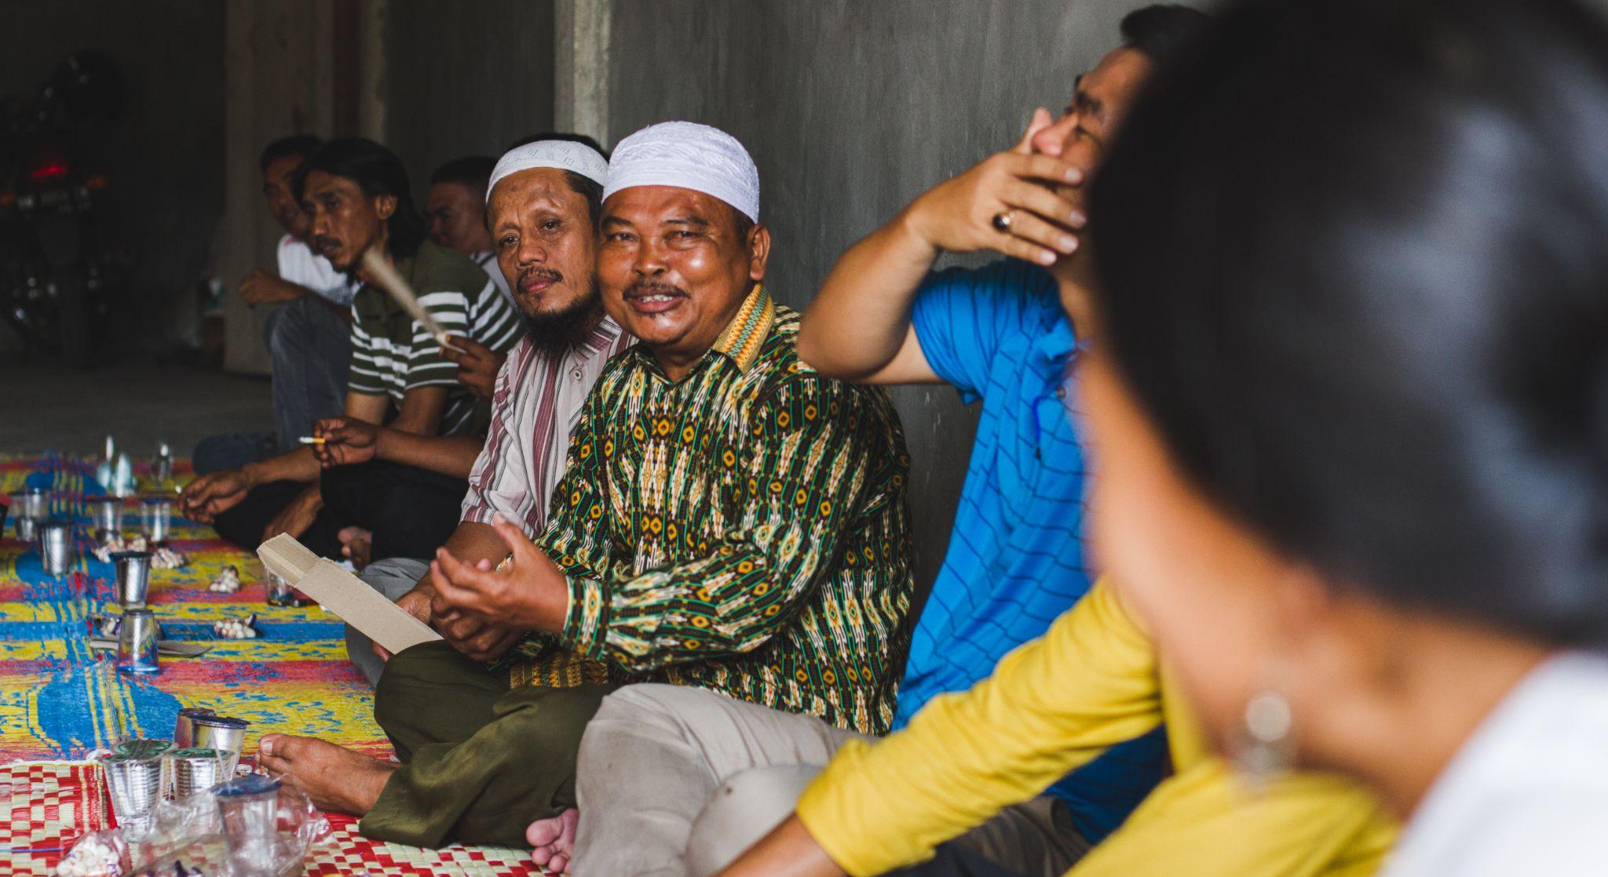
How does this all come together, and where can you go next?
© UNDP Indonesia/Agusriady Saputra

Slide 62
1. Private sector engagement in commodity producing regions is a critical next step for building environmental, social and economic resilience in global agricultural supply chains.
2. Taking strategic action to tackle growing systemic risks now helps ensure business resilience and sustained growth into the future.
HOW DOES THIS ALL COME TOGETHER, AND WHERE CAN YOU GO NEXT?
Key takeaways
3. Multi-stakeholder approaches can address many shortcomings and gaps present in typical market-based approaches, helping to deliver sustainability commitments.
6. There are many examples of organisations already engaging beyond their value chains, which provide practical insight into the opportunities for collaborative action.
5. Private sector companies or financial institutions can engage in a range of different ways, with varying levels of engagement depending on the needs and structure of the organisation.
4. Private sector participation can deliver multiple business benefits, including: a supportive policy environment; investment opportunities; reduced transaction costs; brand reputation and leadership.

Slide 63
The Corporate Action Matrix helps build an approach to engagement
Companies can use this matrix to identify the types of action that they can undertake at different levels and through what forms of interaction, to build a cohesive approach to engaging beyond value chains.
Companies can plot their current and planned activities in this matrix to identify where gaps lie and then identify which gaps should be filled.
The matrix can be used to plot actions for a particular sourcing region, for a particular commodity (e.g., palm oil) or actions on a particular issue (e.g., living income).
An illustrative example is shown on the next page.
Type of action​ |  | Geographic scope of action​
​ | ​ | Farms​ | Landscapes​ | Subnational​ | National​ | Global​
Collective action​ collaborative | Institution building​ | ​ | ​ | ​ | ​ | ​
 | Building coalitions & partnerships​ | ​ | ​ | ​ | ​ | ​
 | Multi-stakeholder forum​ | ​ | ​ | ​ | ​ | ​
Individual or collective action​ coordinated | Technical assistance​ | ​ | ​ | ​ | ​ | ​
 | Funding & finance​ | ​ | ​ | ​ | ​ | ​
 | Advocacy​ | ​ | ​ | ​ | ​ | ​
Individual company and supply chain actions​ uncoordinated | Purchasing contacts/ off-take agreements​ | ​ | ​ | ​ | ​ | ​
 | Supply chain policies/ purchasing requirements​ | ​ | ​ | ​ | ​ | ​
 | Commitments​ | ​ | ​ | ​ | ​ | ​
HOW DOES THIS ALL COME TOGETHER, AND WHERE CAN YOU GO NEXT?

Slide 64
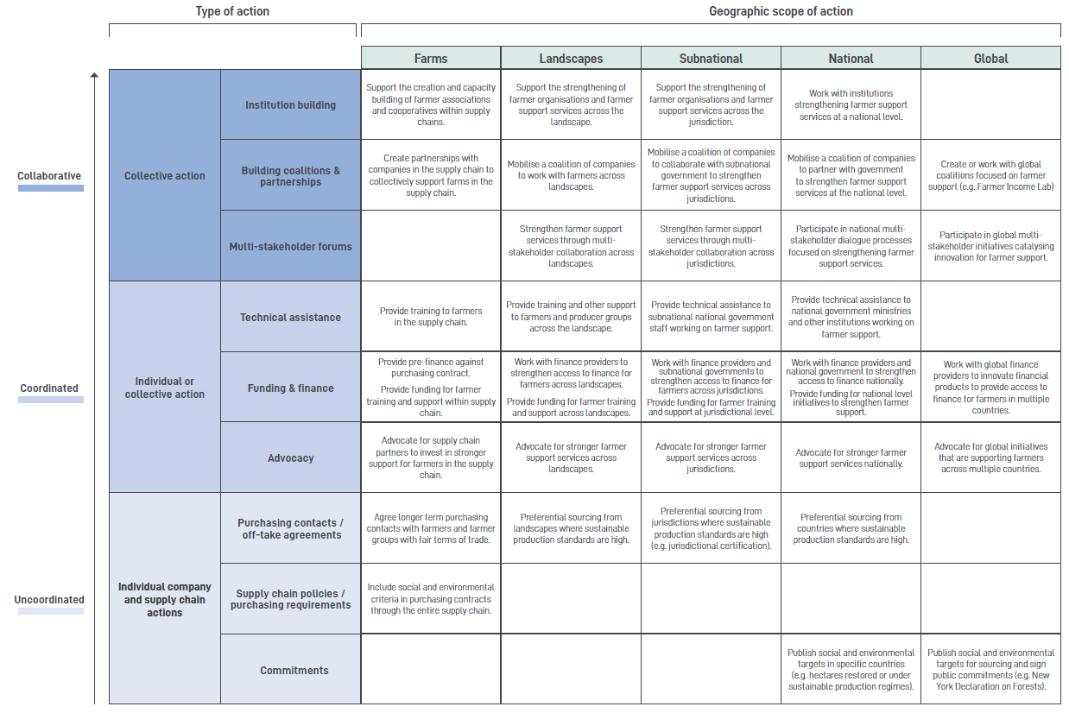
The Corporate Action Matrix – illustrative example
The matrix provides indicative examples of actions on farmer support that might be taken across different geographic scopes, from individual company actions through coordinated actions and collaborative actions.
HOW DOES THIS ALL COME TOGETHER, AND WHERE CAN YOU GO NEXT?

Slide 65
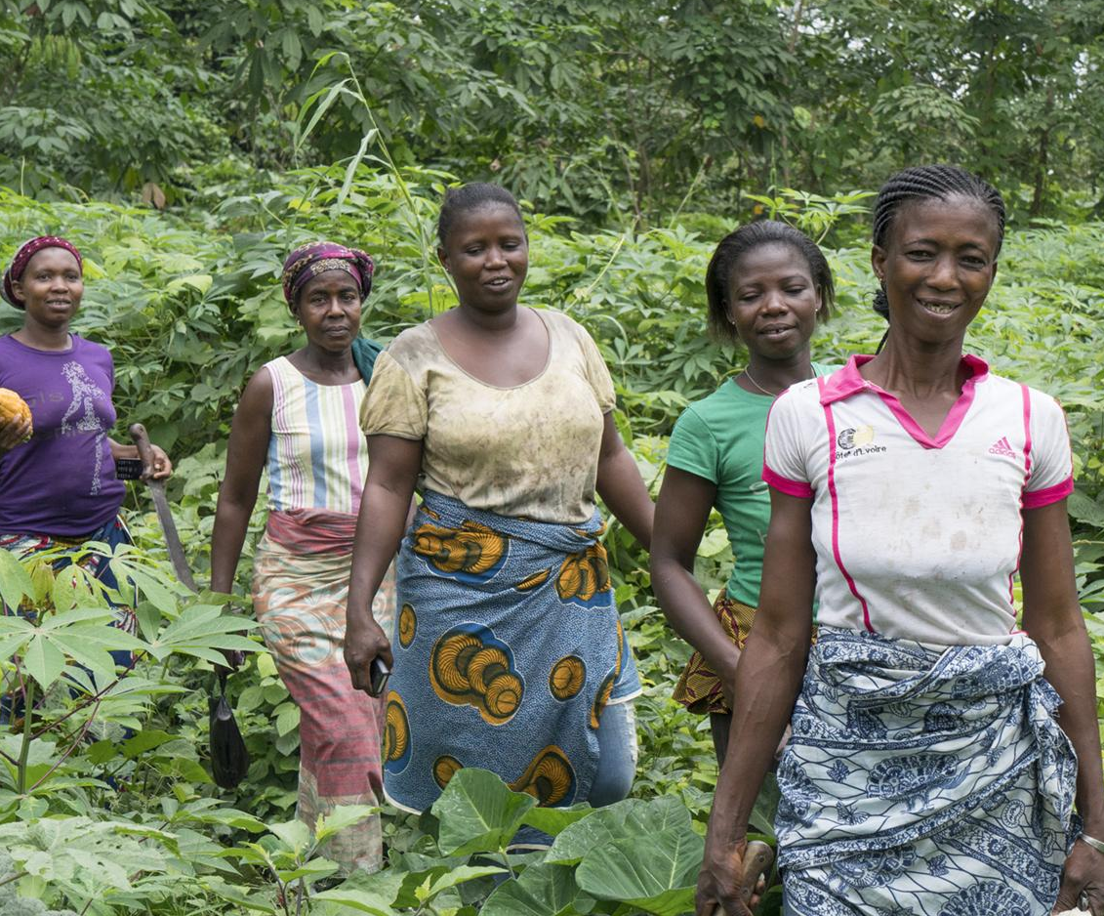
Where do I learn more, and find out what to do next?
Where can I learn more about the importance of engaging beyond value chains?
This guidance note is just the start. There are a growing number of resources that can help businesses to answer questions about how to engage beyond their value chains and to identify specific opportunities to support.
Value Beyond Value Chains Guidance Note:
This guidance note focuses on how companies can collaborate more effectively with governments in producer countries to create the enabling conditions for sustainable agricultural production. Further details of the concepts and recommendations detailed in this deck can be found here.
HOW DOES THIS ALL COME TOGETHER, AND WHERE CAN YOU GO NEXT?
Value Beyond Value Chains Case Studies Collection:
This document provides more detailed case studies of existing examples of businesses working beyond their value chains to promote systemic transformation in commodities production. It also provides case studies of business alliances and other groups working together towards these goals, as well as detailing common challenges and good practices for businesses seeking to engage outside their value chain.
©️ World Cocoa Foundation

Slide 66
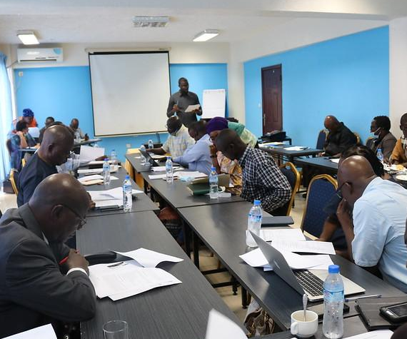
Where do I learn more, and find out what to do next?
Where can I learn more about how jurisdictional approaches have worked in the past, including with the private sector?
This guidance note is just the start. There are a growing number of resources that can help businesses to answer questions about how to engage beyond their value chains and to identify specific opportunities to support.
CDP Analysis of Company support of jurisdictional initiatives in Brazil:
This document presents the most recent developments in jurisdictional initiatives in commodity producing regions in Brazil. The Policy Brief also gives recommendations for the different stakeholders involved in jurisdictional approaches
HOW DOES THIS ALL COME TOGETHER, AND WHERE CAN YOU GO NEXT?
Evidensia:
Evidensia helps you access and interpret credible research on the sustainability impacts and effectiveness of supply chain initiatives and tools. It provides a portal to information and evidence and supports shared learning through its insights and analysis.
©️ UNDP Liberia

Slide 67
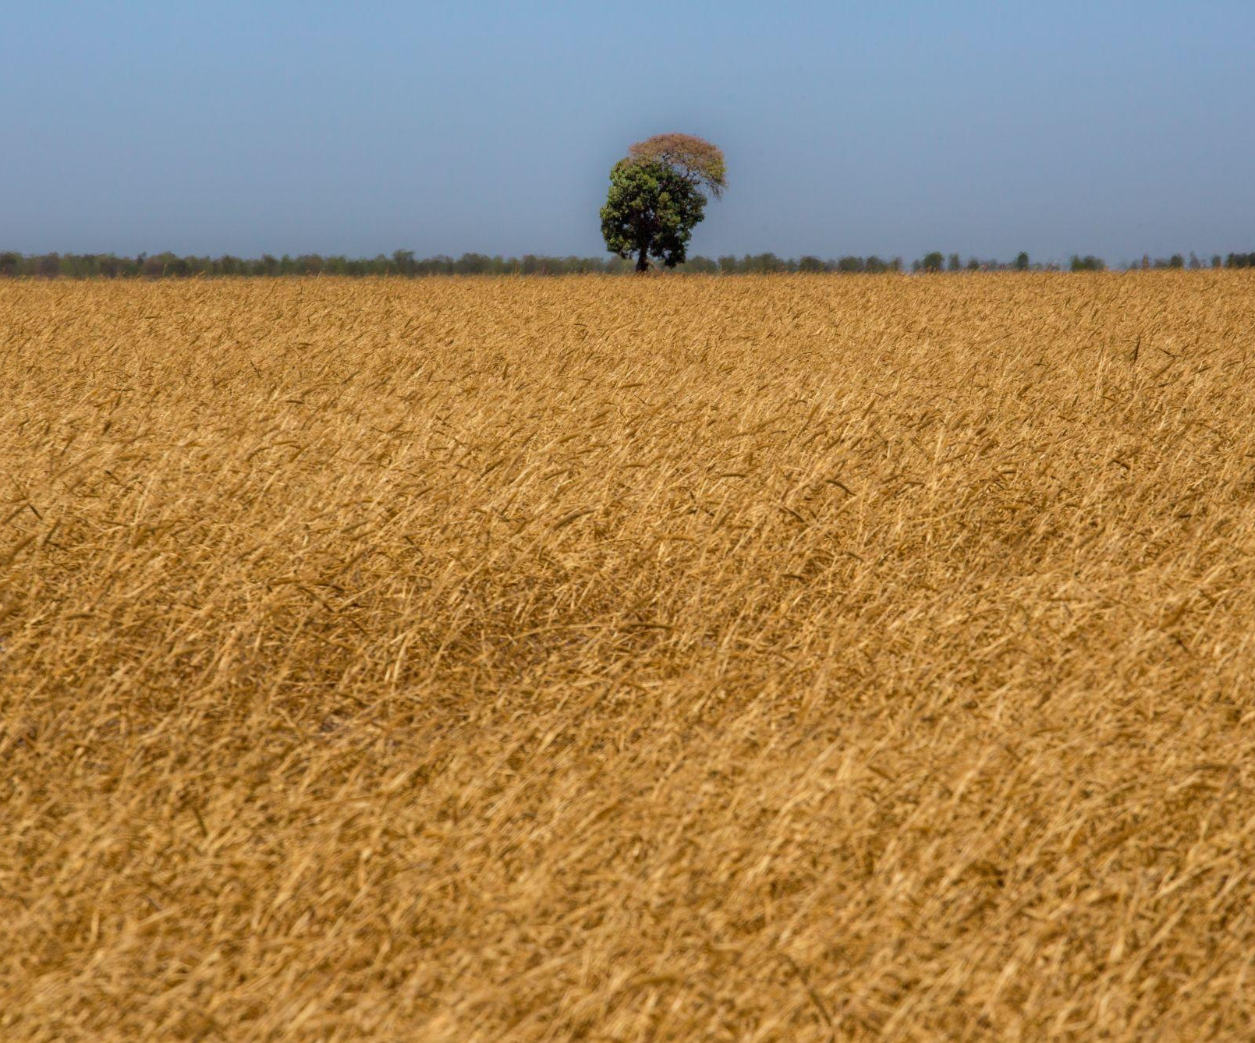
Where do I learn more, and find out what to do next?
Where can I learn more about how to engage with multi-stakeholder programmes beyond my value chain?
This guidance note is just the start. There are a growing number of resources that can help businesses to answer questions about how to engage beyond their value chains and to identify specific opportunities to support.
Jurisdictional Action Network (JAN) & Jurisdictional Approach Resource Hub:
The Jurisdictional Action network is hosted by the Tropical Forest Alliance and serves a growing community of people and organizations who seek to advance Jurisdictional Approaches that support the responsible production and sourcing of forest-risk commodities to achieve sustainable land-use at scale. The Resource Hub provides various resources, tools, and guidance for companies.
HOW DOES THIS ALL COME TOGETHER, AND WHERE CAN YOU GO NEXT?
ProForest Engaging with Landscape Initiatives Guidance:
This guide collates learning on where and how supply chain companies can most effectively engage with landscape initiatives to help meet their commitments, recognising the different roles and participation of other stakeholders in the process. See also their note on engaging with landscape initiatives in Indonesia, and in the Siak Pelalawan Landscape Programme specifically.
©️ Flavio Forner

Slide 68
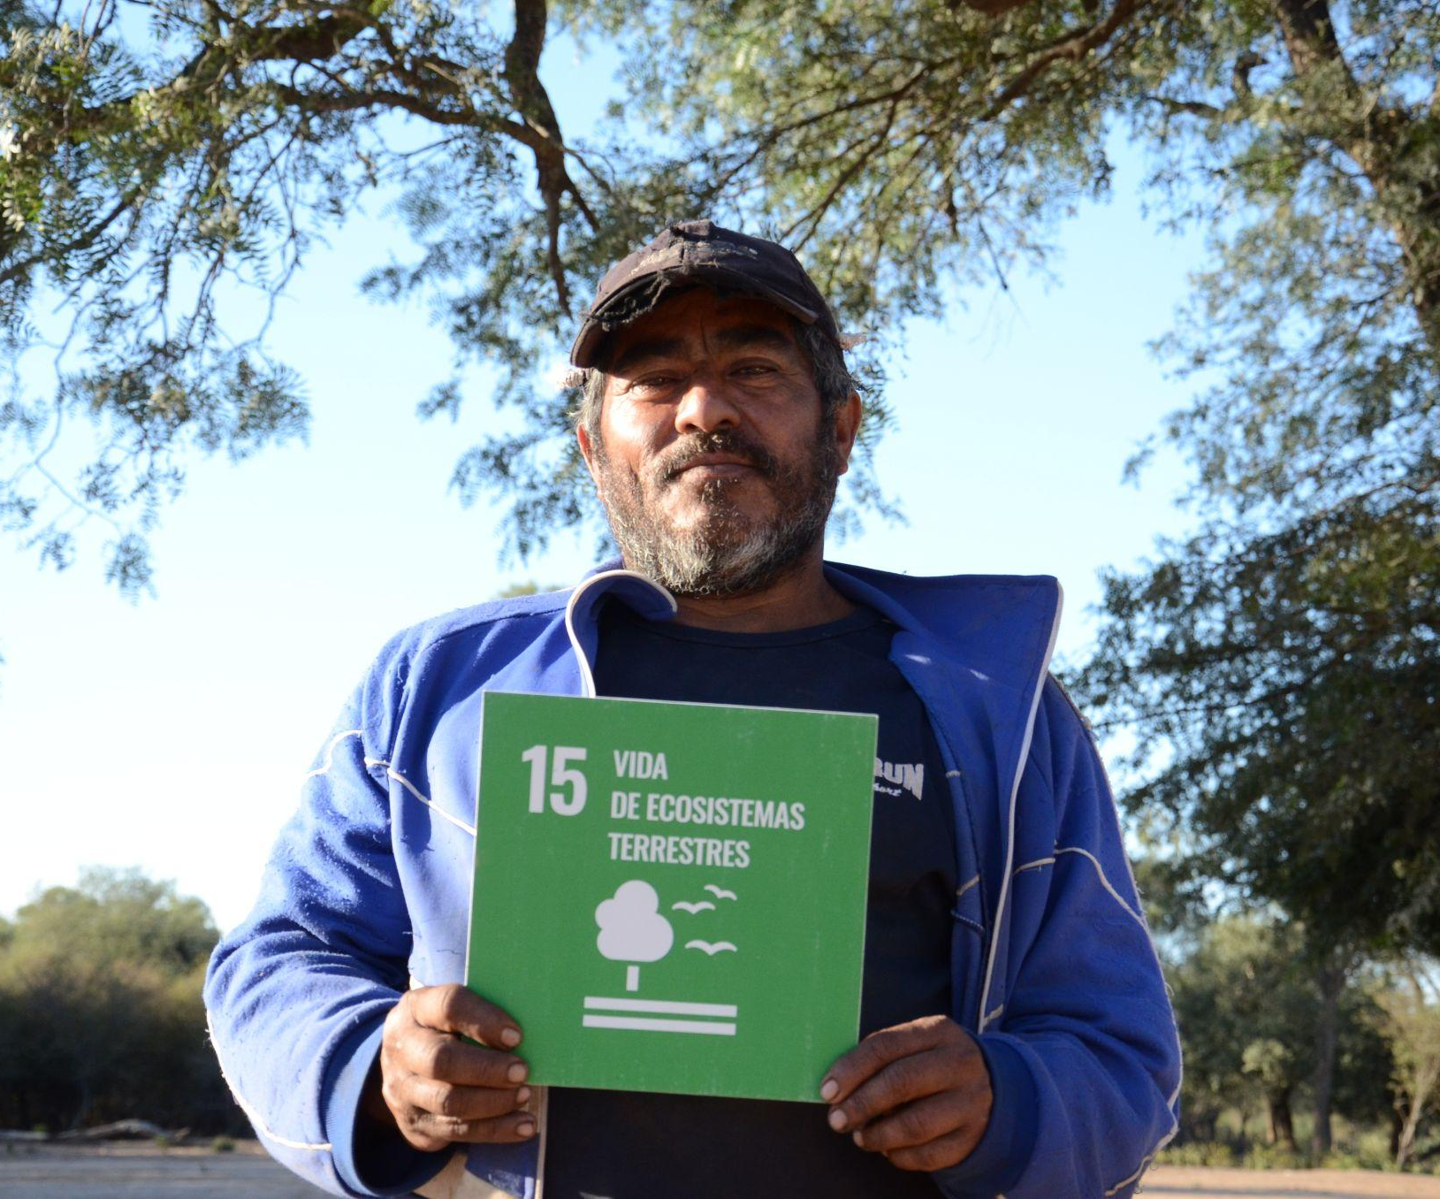
Where do I learn more, and find out what to do next?
Where can I find out more about specific landscapes and jurisdictions that I can support?
This guidance note is just the start. There are a growing number of resources that can help businesses to answer questions about how to engage beyond their value chains and to identify specific opportunities to support.
IDH SourceUp Platform:
SourceUp helps local stakeholders in producing regions come together to work on sustainability through a collaborative effort called a ‘Compact’. A Compact has the power to transform agricultural production systems far beyond what individual producers, local governments, civil society organisations or traders can do alone.
HOW DOES THIS ALL COME TOGETHER, AND WHERE CAN YOU GO NEXT?
Commodities Jurisdictions Platform:
The aim of the Commodities & Jurisdictions Approach (CJA) is to link ambitious jurisdictional forest and climate programs with companies who want to reduce deforestation and associated risks in their commodity supply chains.
©️ Pedro P. Peña

Slide 69
Case studies:
How businesses and financial institutions can collaborate
More detailed case studies can be found in the Value Beyond Value Chains Case Studies Collection
© UNDP Paraguay

Slide 70
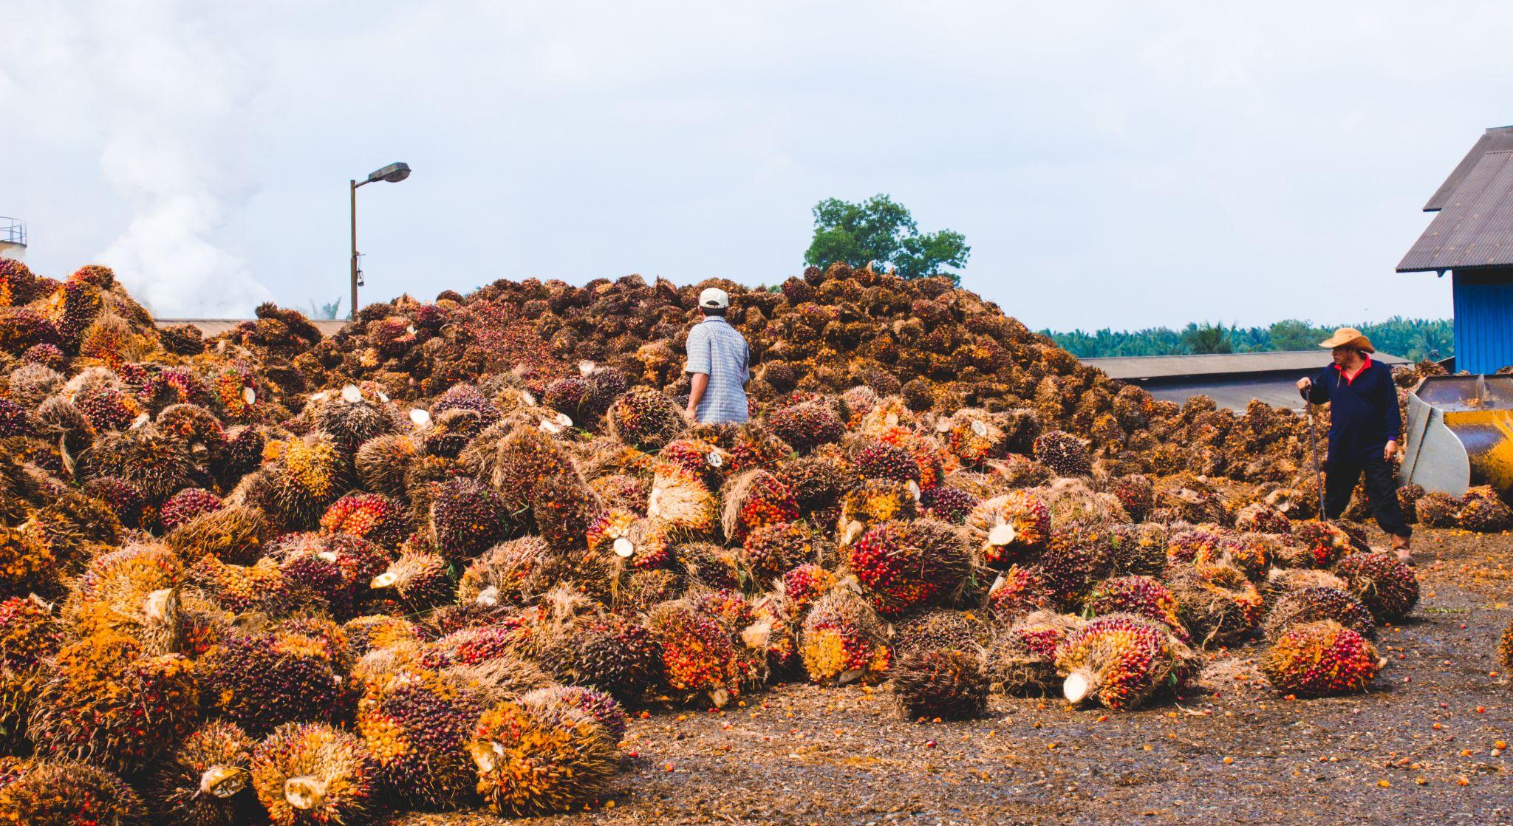
Examples of multi-stakeholder collaboration at different government levels
© UNDP Indonesia/Agusriady Saputra

Slide 71
NATIONAL
Indonesia Sustainable Palm Oil Platform (National Implementation Team)
©️ UNDP Indonesia/Agusriady Saputra
What is it?
The Government of Indonesia, supported by UNDP, convened stakeholders from across the sector to develop a national strategy for sustainable palm oil. The end result is the National Action Plan for Sustainable Palm Oil (NAP SPO) which sets out a vision for sustainability in the Indonesian palm oil sector and sets the baseline of expectations for private sector companies operating in and sourcing from the country.
What has it achieved?
In 2019 the National Action Plan for Sustainable Palm Oil was adopted by Presidential Instruction, with implementation of the plan (2019-2024) mandated for all ministries and palm oil producing provinces and districts. The plan is now being incorporated into laws and implementation plans in provinces and districts across Indonesia.
Who is involved?
The National Action Plan Implementation Team is led by government and involves private sector companies, civil society organisations (CSOs) and universities in multi-stakeholder groups that discuss a variety of aspects including policy, farmer support and implementation. ​
How are companies involved?
GAPKI, the Indonesian Association of Palm Oil Companies, was a key partner in the development of the initiative and in multi-stakeholder dialogues. The process was also directly supported by funding from IKEA and Mondelez. Many other companies participated directly into dialogues (including Ahold Delhaize, Unilever, Johnson & Johnson, Cargill, Asian Agri, Musim Mas). Companies are encouraged to align their sustainability strategy with the NAP SPO to contribute to its implementation. Through their participation in working groups, some companies support the NAP SPO Implementation Team structure led by the government.
EXAMPLES OF MULTI-STAKEHOLDER COLLABORATION AT DIFFERENT GOVERNMENT LEVELS
More info

Slide 72
PROVINCIAL
North Sumatra Platform (Provincial Implementation Team)
©️ UNDP Indonesia/Nicholas Hurt
What is it?
Following the model of the national platform, a multi-stakeholder platform was set up by the provincial government of North Sumatra, with support from UNDP. Now, the Provincial Implementation Team oversees the implementation of the Provincial Action Plan for Sustainable Palm Oil (PAP SPO). The team is mandated to regularly report on progress to the National Implementation Team, and coordinates with platforms at district level, such as in South Tapanuli.​
What has it achieved?
The multi-stakeholder platform led the process of developing and implementing the Provincial Action Plan for Sustainable Palm Oil, which was legalised in 2020. The plan feeds into the national level plan, while also tackling issues specific to the North Sumatra province.
Who is involved?
The platform is led by provincial authorities and involves companies, local CSOs and universities.
How are companies involved?
Member companies of the Provincial Implementation Team are regularly involved in platform discussions on specific palm oil issues. The Indonesian Palm Oil Companies Association/GAPKI North Sumatera Chapter has led thematic discussions on the private sector’s contribution towards ISPO certification. Companies are involved through working groups of the Provincial Implementation Team, and are encouraged to align their sustainability strategy with the PAP SPO. Some companies and NGOs are developing jurisdictional initiatives, such as the Coalition for Sustainable Livelihoods (CSL), or are directly involved in technical activities to support implementation of the PAP SPO.
EXAMPLES OF MULTI-STAKEHOLDER COLLABORATION AT DIFFERENT GOVERNMENT LEVELS
More info

Slide 73
DISTRICT
Siak Pelalawan Landscape Programme
©️ Agusriady Saputra/UNDP Indonesia
What is it?
The Siak Pelalawan Landscape Programme (SPLP) is a private sector-driven initiative in the districts of Siak and Pelalawan in Riau province, Indonesia. Working directly with local governments and other stakeholders, the SPLP supports and builds on existing government led initiatives, in particular the Green Siak Roadmap and the Pelalawan District Action Plan.
What has it achieved?
The SPLP is structured around three phases to 1) design the intervention, 2) define the partnership and then 3) implement the intervention. Phase 1 was completed in June 2019 and SPLP is currently in Phase 2 and 3.
Who is involved?
The programme is initiated by the SPLP Coalition, which consists of Cargill, L’Oréal, Musim Mas, Neste, PepsiCo and Unilever as members and Danone, the Consumer Goods Forum Forest Positive Coalition of Action and Golden Agri-Resources as supporters.
How are companies involved?
Member companies are developing detailed plans to support sustainable palm oil production in the districts, working with local government, across four areas: effective monitoring; enforcement and response; launching a village support programme; and delivering incentives. Through this involvement, companies contribute to the implementation of the Pelalawan District Action Plan for Sustainable Palm Oil and the Green Siak Roadmap.
EXAMPLES OF MULTI-STAKEHOLDER COLLABORATION AT DIFFERENT GOVERNMENT LEVELS
More info
Case study research done based on publicly available sources.

Slide 74
LANDSCAPE & MULTI-SCALE
(Provincial & District)
Coalition for Sustainable Livelihoods (CSL)
©️ Shutterstock
What is it?
The Coalition for Sustainable Livelihoods (CSL) is a multi-stakeholder, place-based platform that provides a forum for stakeholders to understand their shared interests, align around common objectives, and drive collective action and investment to advance sustainable development goals across North Sumatra and Aceh in Indonesia. The CSL is helping to create stronger alignment between government programmes and policies such as the Indonesian National Action Plan for Sustainable Palm Oil, the North Sumatra Provincial Action Plan, and private sector investments in sustainable supply chains.
What has it achieved?
As an outcome of two workshops consisting of ~130 participants each, five working groups, broad stakeholder engagement across government, private sector, financial institutions and civil society, and advisory from its Interim Steering Group, CSL defined a common vision and three-year roadmap for operationalizing the platform. A CSL secretariat has been established, metrics are being developed, and collectively, CSL partners are leading initiatives in three districts that are focused on building smallholder farmer productivity, halting illegal deforestation, restoring degraded lands and strengthening forest management.​
Who is involved?
CSL is establishing a membership model. Past and current partners include: Barry Callebaut, Conservation International (CI), Danone, Earthworm Foundation, The Sustainable Trade Initiative (IDH), The Livelihoods Fund, Mars Wrigley, Mondelēz International, PepsiCo, Unilever and the United Nations Development Programme (UNDP) through the Good Growth Partnership.
How are companies involved?
Private sector partners are participating in CSL’s Interim Steering Group, investing in CSL’s platform and landscape/district initiatives, and leveraging funding to catalyse new, complementary initiatives.
EXAMPLES OF MULTI-STAKEHOLDER COLLABORATION AT DIFFERENT GOVERNMENT LEVELS
More info
Case study research done based on publicly available sources.

Slide 75
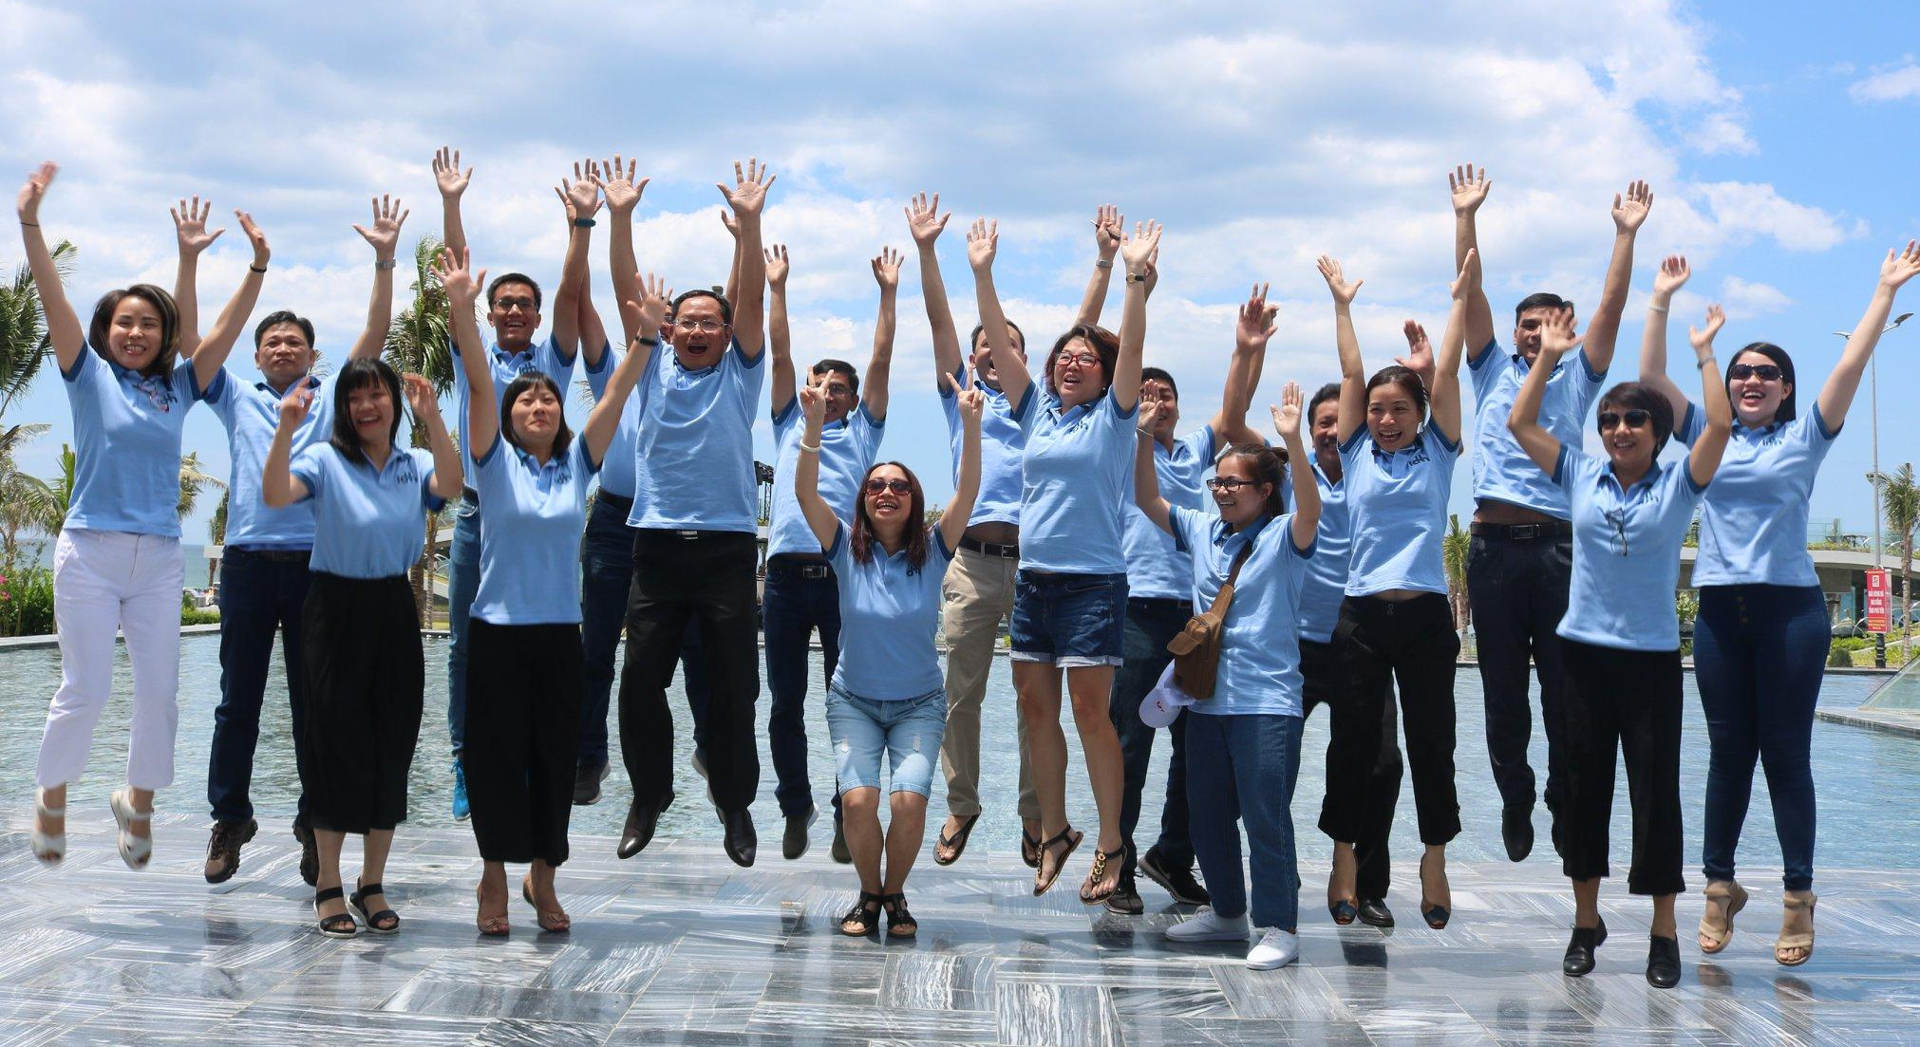
Examples of business engagement collaborating for impact beyond their value chains
© IDH SourceUp

Slide 76
Cocoa & Forests Initiative
©️ World Cocoa Foundation
What is it?
The Cocoa & Forests Initiative (CFI) is an active commitment of top cocoa-producing countries (Côte d’Ivoire, Ghana and Colombia) with leading chocolate and cocoa companies to end deforestation and restore forest areas. The Initiative works predominantly at a national level, but is also operating at a landscape level through connections to Ghana’s Reducing Emissions from Deforestation and forest Degradation (REDD+) programme.​
What has it achieved?
Supported by these national governments, corporate members have distributed almost 13 million forest trees since 2018 and have reached 72% traceability in direct sourcing in both Côte d´Ivoire and Ghana. In 2021, 723,000 farmers have been trained in good agricultural practices and 253,000 have gained access to markets and finance for sustainable production.​
Who is involved?
The Initiative is chaired by the governments of Côte d’Ivoire, Ghana, and Colombia, and is facilitated by The Sustainable Trade Initiative (IDH) and the World Cocoa Foundation. In 2019, the Initiative was expanded to Colombia.​
How are companies involved?
Companies work with national governments to develop implementation plans based on the jointly agreed national priorities. The CFI’s model of collaboration – connecting governments, private sector companies and other stakeholders to build a jointly held positive vision and plan of action – has great potential in other commodity-producing regions. ​
EXAMPLES OF BUSINESS ENGAGEMENT COLLABORATING FOR IMPACT BEYOND THEIR VALUE CHAINS
More info

Slide 77
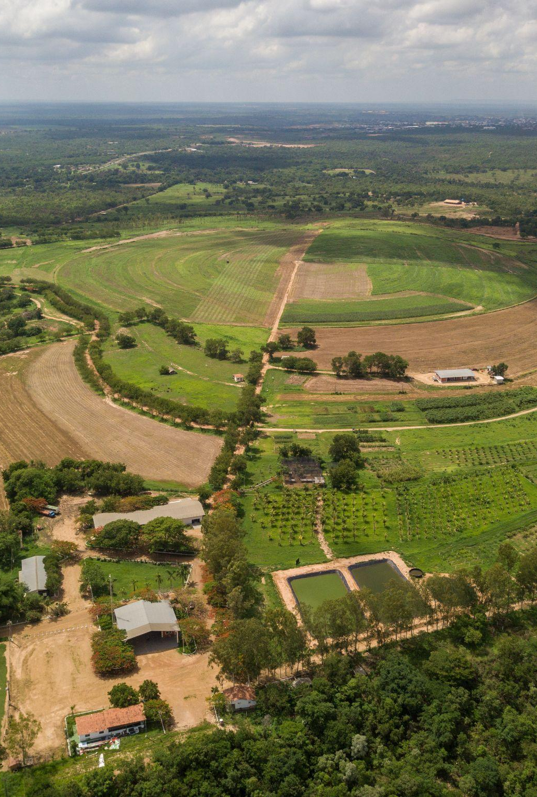
The Soft Commodities Forum
©️ Fellipe Abreu
What is it?
The Soft Commodities Forum (SCF) brings together major agribusinesses working with governments, producers, consumers and civil society, to advance shared action on a conversion-free soy supply chain in the Cerrado. The SCF is committed to improving sector transparency and traceability of soy supply chains through voluntary standards for monitoring and verifying progress on company commitments, with a goal to track and eliminate native vegetation conversion.
What has it achieved?
Today, SCF members buy 90% of their soy directly from farms in the original 25 priority municipalities of the initiative, and can trace 100% of these direct purchases to farm level.
Who is involved?
The SCF was established in 2018 by the World Business Council​ for Sustainable Development (WBCSD), bringing together six major agribusinesses (ADM, Bunge, Cargill, COFCO International, Louis Dreyfus Company (LDC), and Viterra) to work at a landscape level.
How are companies involved?
The SCF members participate in several multi-stakeholder platforms, presenting their aligned vision and interacting with other actors, including governments, to build consensus on shared needs and activities. The SCF has collaborated at a jurisdictional level to identify farmer needs in the Cerrado with the Produce, Conserve, Include (PCI) Institute. At the COP26 World Leaders Summit on Forests and Land Use, all six SCF members communicated their joint commitment to develop, by COP27, a sector-wide roadmap for supply chain action that is consistent with a 1.5° C pathway.​
EXAMPLES OF BUSINESS ENGAGEMENT COLLABORATING FOR IMPACT BEYOND THEIR VALUE CHAINS
More info

Slide 78
The Cerrado Working Group/Grupo de Trabalho do Cerrado (GTC)
©️ Gustavo Leighton
What is it?
The Cerrado Working Group/GTC is a Brazilian multi-stakeholder forum established to put forward an action plan for eradicating deforestation and conversion of native vegetation in Brazil’s Cerrado biome. The group collaborates with branches of the Brazilian national government, including the Ministries of Agriculture and Environment, to work on policy and financing for sustainable production of soy on existing agricultural land in the Cerrado, to avoid further land conversion.
What has it achieved?
In 2017, over 60 Brazilian NGOs released the Cerrado Manifesto, a call for “immediate action in defence of the Cerrado by companies that purchase soy and meat from within the biome, as well as by investors active in these sectors” and 23 global brands signed the Statement of Support for the objectives of the Cerrado Manifesto. The GTC has engaged with soy processors and retailers of processed soy products to fund payments for conservation and avoid legal deforestation. It has also established negotiations with foreign buyers to propose a variety of policy instruments, including for conservation beyond legal requirements.
Who is involved?
The initiative is composed of soy industry members, NGOs including WWF, producer organisations, civil society organisations, governments, financial institutions and Brazilian consumer goods companies.​
How are companies involved?
Private sector actors such as the Soft Commodities Forum member companies participate in the processes of the Working Group to align on common definitions and outline actions to be taken. Signatories of the Cerrado Manifesto Statement of Support launched the Cerrado Funding Coalition, to generate the funding necessary to create a financial payment mechanism providing fair financial incentives for farmers to conserve forest, and to transition to producing soy only on existing agricultural land.
EXAMPLES OF BUSINESS ENGAGEMENT COLLABORATING FOR IMPACT BEYOND THEIR VALUE CHAINS
More info
Case study research done based on publicly available sources.

Slide 79
Consumer Goods Forum (CGF) Forest Positive Coalition
©️ UNDP Indonesia/Agusriady Saputra
What is it?
The Consumer Goods Forum (CGF) Forest Positive Coalition is a CEO led initiative representing 20 member companies. The Coalition is committed to leveraging collective action and accelerating systemic efforts to remove deforestation, forest degradation and conversion from key commodity supply chains. It has instigated a series of constructive dialogues with the Brazil Government and has articulated an intention to build similar dialogues with the governments of China, Indonesia and the EU.
What has it achieved?
The Coalition has engaged with nearly 100 organisations across industry, civil society and government and developed Commodity Roadmaps and Coalition-wide Actions. It has also established a digital dialogue platform for coalition members and civil society stakeholders known as Evergreen.
Who is involved?
The Forest Positive Coalition of Action was created by The CGF and is led by 20 companies including Unilever, Mars and Nestle. The coalition mobilises the leading position of its member to send strong signals to other stakeholders including national governments and international institutions.
How are companies involved?
Companies have been involved in Commodity Working Groups and engaged in stakeholder communications to create community roadmaps.
EXAMPLES OF BUSINESS ENGAGEMENT COLLABORATING FOR IMPACT BEYOND THEIR VALUE CHAINS
More info
Case study research done based on publicly available sources.

Slide 80
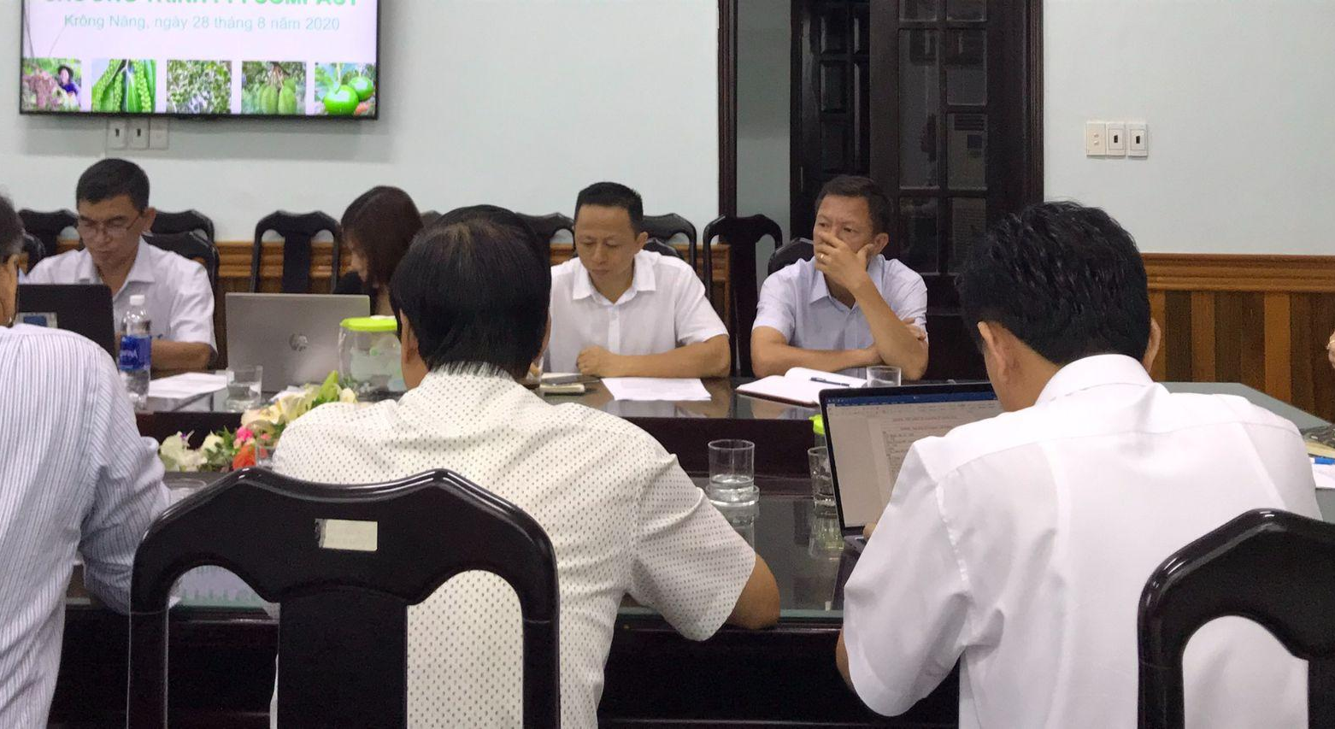
Examples of actions taken by companies and financial institutions in different parts of the value chain
© UNDP Indonesia/Agusriady Saputra

Slide 81
PRODUCERS:
Wilmar International
©️ UNDP Indonesia/Agusriady Saputra
What sustainability commitments has the company made?
Wilmar International is a food production and processing corporation with over 300 subsidiaries. The group committed to a No Deforestation, No Peat, No Exploitation (NDPE) policy in 2013, which extends across global operations, including joint-venture partners and third-party suppliers.
What has it achieved?
Wilmar has achieved 98% traceability to mills and is on track for 100% by 2022. 77% of Wilmar’s own plantation land is Roundtable Sustainable Palm Oil (RSPO) certified; and more than 20 million hectares managed by suppliers is monitored and screened for ecological compliance. 1.8 million hectares has been removed for non-compliance.
Which multi-stakeholder initiatives is it involved in?
Wilmar is a member of various multi-stakeholder coalitions, including the Tropical Forest Alliance, Grow Asia and Grow Africa; regional partners of WEF’s New Vision for Agriculture initiative, in which it leads on partnership building with governments and innovation solutions. Wilmar also co-chairs the RSPO’s Smallholder Working Group and Biodiversity and High Conservation Value HCV Working Group, to support smallholder certification and HCV compensation processes for state governments.
How is it collaborating with governments?
Wilmar also tackles deforestation and sustainable farming at a jurisdictional level. In Sabah, Malaysia, it is part of the Jurisdictional Certification Steering Committee (JCSC), helping the Sabah government achieve its vision of 100% RSPO-certified palm oil by 2025 - with 25,000 smallholders over 170,000 hectares producing sustainably.
EXAMPLES OF ACTIONS TAKEN BY COMPANIES AND FINANCIAL INSTITUTIONS IN DIFFERENT PARTS OF THE VALUE CHAIN
Case study research done based on publicly available sources.

Slide 82
TRADERS:
Olam Food Ingredients​
©️ World Cocoa Foundation
What sustainability commitments has the company made?
Olam Food Ingredients (OFI) is among the world's largest traders of cocoa products, coffee, cotton and rice. The company’s sustainability framework focuses on 10 material areas mapped to relevant Sustainable Development Goals (SDGs). OFI believes that Non-Financial Capital such as Natural Capital and Social Capital (relationships with suppliers and communities) is critical to build trust with stakeholders and, ultimately, ensure long-term profitability and license to operate. ​
What has it achieved?
In 2020, OFI achieved 100% traceability for its directly sourced cocoa beans. Working with the Cocoa & Forests Initiative, OFI has trained over 65,000 farmers in good agricultural practices and is co-managing the restoration of 460,000 hectares degraded forest in Côte d’Ivoire.
Which multi-stakeholder initiatives is it involved in?
More than 90 partners - including customers, NGOs, Development Finance Institutions (DFIs), and governments – are involved in OFI´s sustainability programmes, and the company participates in various multi-stakeholder platforms such as the Tropical Forest Alliance, the Roundtable Sustainable Palm Oil (RSPO) and the Cocoa Fair Labour Association and the Cocoa Fair Labour Association.
How is it collaborating with governments?
OFI works with governments at local, national and jurisdictional levels. In Nigeria, it worked with multiple partners including the federal government to train farmers and provide improved seeds, fertilisers, and threshers under a soft loan scheme. OFI has also worked on a joint venture with the Government of Gabon to create Olam Palm Gabon; the largest RSPO-certified palm plantation in Africa.
EXAMPLES OF ACTIONS TAKEN BY COMPANIES AND FINANCIAL INSTITUTIONS IN DIFFERENT PARTS OF THE VALUE CHAIN
Case study research done based on publicly available sources.

Slide 83
MANUFACTURERS:
Unilever
©️ Shutterstock
What sustainability commitments has the company made?
Unilever is one of the world’s largest buyers and processors of tropical commodities, and is committed to achieving a deforestation-free supply chain by 2023.
What has it achieved?
Unilever was the first consumer goods company to publish a full list of the palm oil suppliers and third-party mills in its supply chain, along with a public grievance report so that issues associated with direct and indirect palm oil suppliers could be identified and acted on. In 2020, 67% of the company’s agricultural raw materials were sustainably sourced compared to 14% in 2010.
Which multi-stakeholder initiatives is it involved in?
Engagement beyond value chains is a core part of Unilever’s sustainability strategy. The company supports multiple jurisdictional projects that focus on sustainable palm oil production, reduced deforestation and ecosystem conservation in Indonesia and Malaysia. As well as being one of the driving partners behind the Coalition for Sustainable Livelihoods, Unilever is an active member of commodity roundtables such as the RoundTable on Responsible Soy and the Roundtable on Sustainable Palm Oil (RSPO). Unilever is part of a consortium of companies working with Global Forest Watch to develop radar technologies to detect and monitor deforestation in near live-time.
How is it collaborating with governments?
Notable projects which involve collaborating with governments at jurisdictional and local levels in Indonesia include working with IDH Sustainable Trade Initiative in Aceh and with Conservation International in North Sumatera. In 2017, Unilever signed an memorandum of understanding (MoU) with the provincial government of Central Kalimantan, the district government of Kotawaringin Barat and Yayasan Penelitian Inovasi Bumi as part of a jurisdictional approach for sourcing sustainable palm oil at village level. The company is working with Yayasan Inobu (a non-profit research institute), local governments and farming co-operatives to provide smallholder farmers with technical assistance and RSPO certification​.
EXAMPLES OF ACTIONS TAKEN BY COMPANIES AND FINANCIAL INSTITUTIONS IN DIFFERENT PARTS OF THE VALUE CHAIN
Case study research done based on publicly available sources.

Slide 84
RETAILERS:
Walmart
©️ UNDP Paraguay
What sustainability commitments has the company made?
Walmart Inc. is a multinational retail corporation that operates in the United States and internationally. As a major buyer of tropical commodities, Walmart focuses on improving the sustainability of key commodities that drive deforestation. Its forest goals include sourcing 100% deforestation-free verified beef (by 2022) and soy (by 2023) from critical landscapes in Brazil, Argentina and Paraguay; and sourcing only Roundtable on Sustainable Palm Oil (RSPO)-certified palm oil.
What has it achieved?
Walmart launched its consortium Project Gigaton in 2017 to reduce one Gigaton of greenhouse gases (GHG) emissions from its global value chain by 2030. Over 3,100 suppliers have signed up to the initiative, which provides a pathway for suppliers to report progress and guidance on engaging in place-based partnerships for forest conservation. Walmart cites benefits for climate, cost, water, and GHG reductions from its collaborative activities. It regards its capacity to ‘reach across boundaries’, support suppliers and lead industry-wide change as a responsibility to become a ‘regenerative force’ for forests globally.
Which multi-stakeholder initiatives is it involved in?
The Walmart Foundation has invested in initiatives to monitor, restore and conserve critical landscapes, including the World Resource Institute’s Global Forest Watch tool and the MapBiomas project. Beyond its value chain, Walmart is a member of the Forest Positive Coalition: a group of 20 major manufacturers and retailers taking action to reduce deforestation and degradation.
How is it collaborating with governments?
The Forest Positive Coalition has been actively setting the stage for government engagement, and leading commodity-related stakeholder consultations.
EXAMPLES OF ACTIONS TAKEN BY COMPANIES AND FINANCIAL INSTITUTIONS IN DIFFERENT PARTS OF THE VALUE CHAIN
Case study research done based on publicly available sources.

Slide 85
FINANCE:
Rabobank
©️ UNDP Paraguay
What is it?
Headquartered in the Netherlands, Rabobank is a cooperative bank with a strong focus on the agricultural sector, and a commitment to addressing global food issues. Rabobank recognises the pressure on companies to demonstrate a positive contribution to ecosystem restoration and to society, beyond business opportunities.
What has it achieved?
In 2017, Rabobank and the FPSA launched the AGRI3 Fund to unlock $1 billion towards deforestation-free, sustainable agriculture and land use. The fund increases access to sustainable production techniques that contribute to forest protection and inclusive growth. In 2020 the Rabo Foundation provided 261 farmer organisations in 22 countries in Asia, Africa and Latin America with more than €30.6 million USD in impact finance and technical assistance – strengthening the livelihoods of three million farmers.
Who is involved?
With UN Environment, Rabobank is an initiating partner of the Partnership for Forest Protection and Sustainable Agriculture (FPSA), which brings together companies involved in the production, processing, trade or sale of agricultural commodities. All partners share a belief in the need for change, including the critical role of the finance sector to transition to sustainable land use at scale. In Brazil, Rabobank and the FPSA have been working with Gazarini group to install Integrated Crop-Livestock Forest (ICLF) systems – a climate-smart agriculture technique that rotates land use to achieve equivalent yields using six times less land – on 17 million hectares in its portfolio.
How are companies involved?
Rabo Partnerships improve cooperation and knowledge sharing between the private and public sectors. With WWF Brazil, Rabobank organised sector dialogues on sustainability and biodiversity, inviting stakeholders from business, local governments and knowledge institutions.
EXAMPLES OF ACTIONS TAKEN BY COMPANIES AND FINANCIAL INSTITUTIONS IN DIFFERENT PARTS OF THE VALUE CHAIN
Case study research done based on publicly available sources.

Slide 86
FINANCE:
&Green
©️ Conservation International
What is it?
&Green is an investment vehicle financing commercial projects in tropical countries with the aim to delink deforestation from major agri-commodity supply chains and generate long-lasting and scalable climate impact. &Green was launched in 2017 with an overarching impact target of 15 million hectares of forest conserved and 500,000 households benefiting per USD 1 billion invested. All of &Green’s clients commit to: an organisation-wide No Deforestation No Peat No Exploitation (NDPE) Policy; an Environmental and Social Action Plan (ESAP); and a Landscape Protection Plan (LPP) developed with clients that describes and monitors the direct and indirect impacts of projects.
What has it achieved?
&Green invests in ambitious projects run by industry influencers to shift business models to sustainable production, creating scalable blueprints for other players to follow. With a portfolio of USD 114 million, its investments so far have enabled the conservation of more than 1.4 million hectares of forest and improved the livelihoods of more than 10,000 households across Brazil, Colombia and Indonesia. ​
Who is involved?
&Green works in close collaboration with existing initiatives working to protect and restore tropical forests. &Green and the Good Growth Partnership have signed a Statement of Intent to collaborate towards removing deforestation from commodity supply chains. During COP26, &Green also announced its signatory in Innovative Finance for the Amazon, Cerrado and Chaco (IFACC) and in the Forest Investor Club. Other partnerships include the Ford Foundation, NCIA Alliance, Climate Shot Coalition, and two World Resources Institute initiatives: 20x20 and AFR100.
How are companies involved?
&Green supports and requires its investees to engage with communities and local, regional and national governments. It supports governments’ progressive forest protection policies by only investing in jurisdictions assessed and approved by its ‘Jurisdictional Eligibility Criteria Assessments’ (JECAs). The selected jurisdictions are areas with significant forest resources and progressive forest and/or peat protections agendas, ensuring their regulatory frameworks will support and long-term secure the forest protection achievements realised through &Green’s work with the private sector and the inclusion of communities and civil society organisations (CSOs). ​
EXAMPLES OF ACTIONS TAKEN BY COMPANIES AND FINANCIAL INSTITUTIONS IN DIFFERENT PARTS OF THE VALUE CHAIN

